Slide 1
1.1 Foundations of risk management
Definition of risk
Components of the risk
Types of risks
Risk management tools

Slide 2
Definition of risk (1/2)
The International Organization for Standardization (ISO) Guide 73 provides basic vocabulary to develop common understanding on risk management concepts and terms across different applications. ISO Guide 73:2009 defines risk as:
effect of uncertainty on objectives
Note 2: Objectives can have different aspects (such as financial, health and safety, and environmental goals) and can apply at different levels (such as strategic, organization-wide, project, product and process).
Note 4: Risk is often expressed in terms of a combination of the consequences of an event (including changes in circumstances) and the associated likelihood of occurrence.

Slide 3
Definition of risk (2/2)
effect of uncertainty on objectives
If car producer detects a flaw in a safety system and decide to buy back sold cars, car producer doesn't have a risk, it has a loss
If car producer detects a flaw in a safety system and decide to conceal it, car producer is exposed to Reputation and Legal risk (known risk)
If car producer doesn’t detect any flaws in the safety system, car producer is still exposed to risk that it may exists (unknown risk)

Slide 4
Types of risks in Bank:
1. Credit risk
2. Market risk of trading book
3. Liquidity risk
4. Interest rate
5. Currency risk
6. Operational risk
7. Legal and regulatory risk
8. Business and strategic risk
9. ESG risk
10. Reputation risk

Slide 5
Risk management process

Slide 6
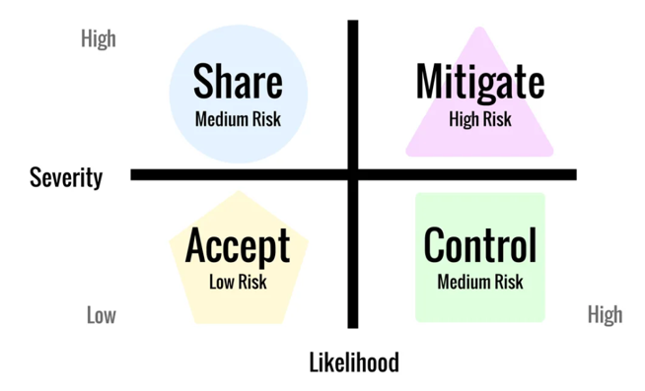
Components of risk and risk measurement
The probability that a risk event will occur during the predetermined period – likelihood
The impact or consequence of the event if it occurs – severity (the price you pay)
2. Measure
3. Manage

Slide 7
Risk management tools
Accept:
Thresholds
Limits
Share:
Insurance
Joint products
Hedging
Control:
Reporting (watch list/warning signals and etc.)
Mitigate:
Rejection
Collateral
Covenants

Slide 8
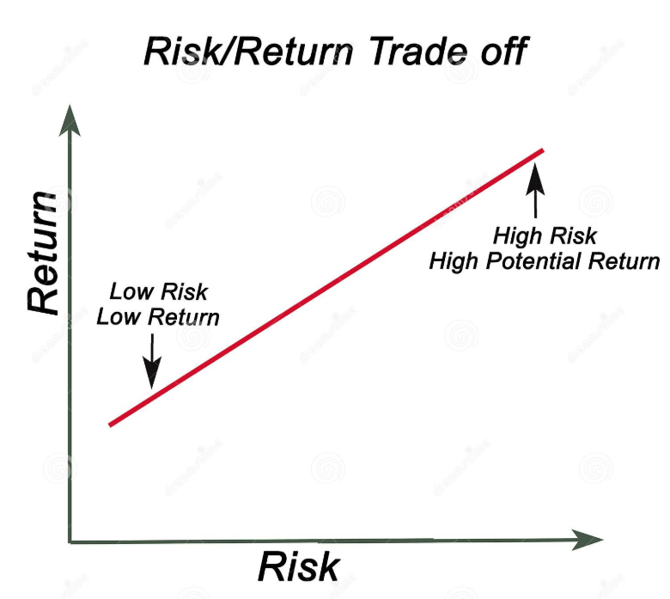
Risk/Return tradeoff

Slide 9
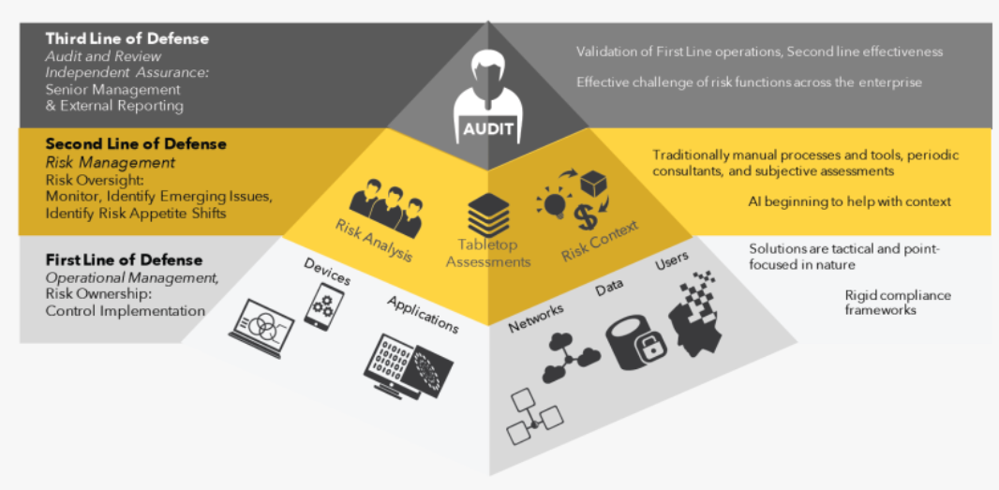
Lines of defense

Slide 10
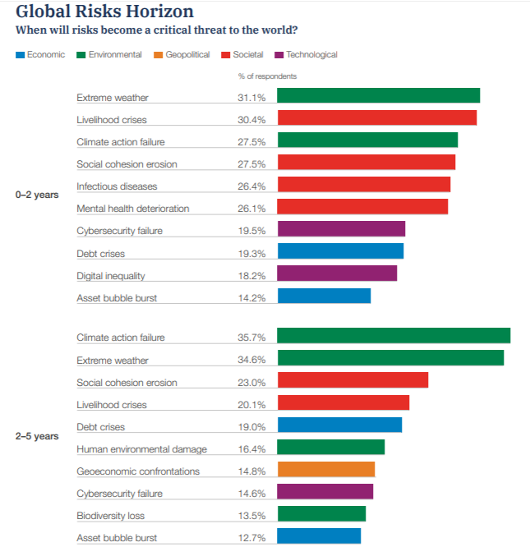
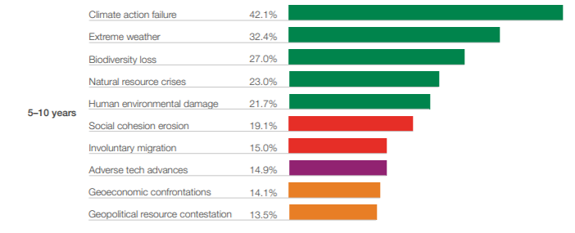
Global risk report

Slide 11
1.2 Foundations of risk management
Foundations of finance in banking

Slide 12
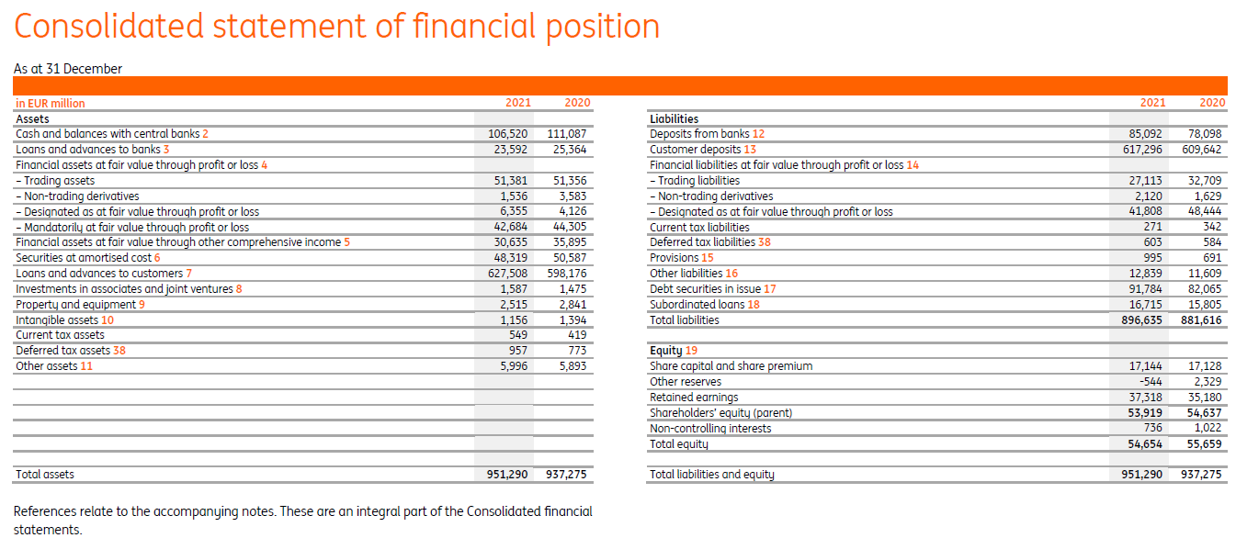
Introduction to banking finance – Balance sheet of the Bank
IE 1.0

Slide 13
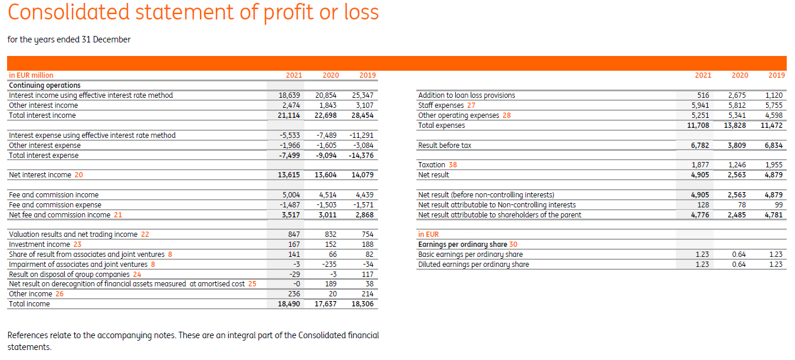
Introduction to banking finance – P&L of the Bank
IE 1.0

Slide 14
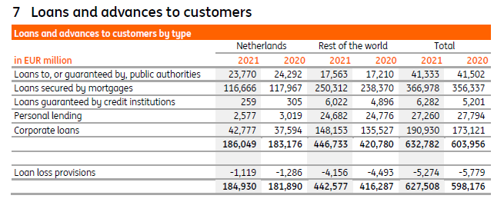
Introduction to banking finance – Main disclosures
IE 1.0

Slide 15
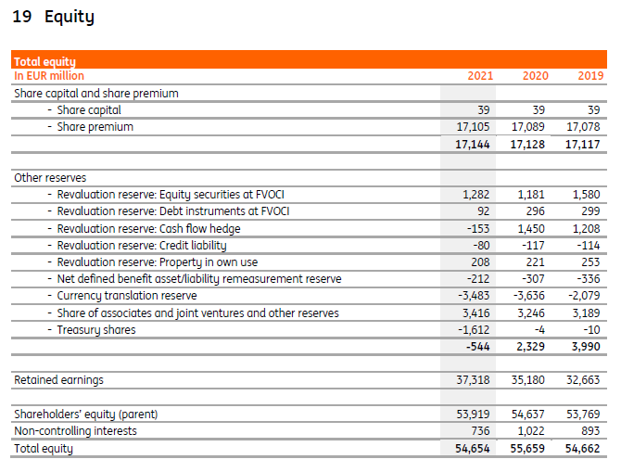
Introduction to banking finance – Capital of the Bank
IE 1.0
Events affecting capital of the Bank:
Sum of all incomes, revaluations, provisions and costs => retained earnings
Dr Loans | Cr Interest income (interest accrued)
Dr Addition to loan loss provisions | Cr Loans (recognition of credit risk on the loans)
Dr FV of securities | Cr Income on revaluation (increase of the Fair value of securities in banking’s portfolio)

Slide 16
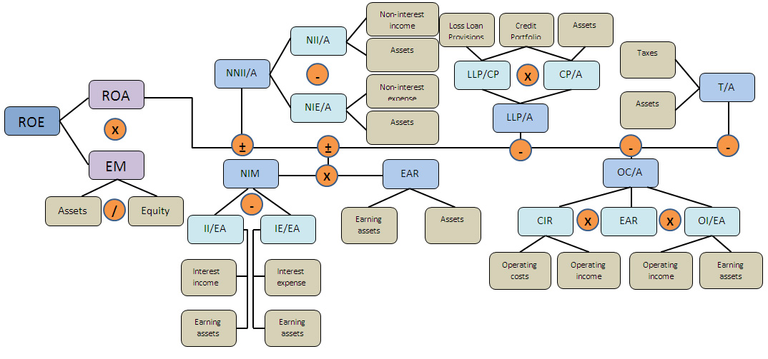
ROE tree – useful framework for financial analysis of the bank
IE 1.1

Slide 17
1.3 Foundations of risk management
Practical application of risk management in banking

Slide 18
Practice of risk management in banking
Subject | Macroprudential level | Entity level
Objective | Limit financial system-wide distress: Protect consumers Prevent bank runs Minimize systemic risk | Limit distress of individual institution: Minimize losses Prevent bankruptcy
Instruments of Risk management | Basel I, II, III Deposit insurance Reserve requirements Banking product regulation* | Share Mitigate Accept Control
*absence of “fine print”, indication of effective interest rate of the loan, limitation of collection procedures and many others

Slide 19
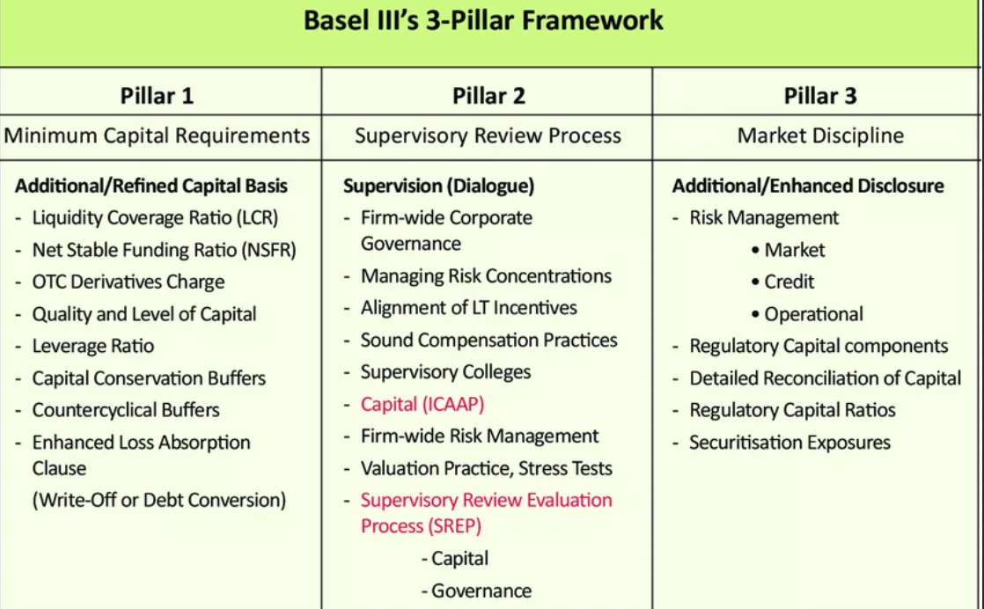
Basel

Slide 20
Activity of the bank under Pillar I
Regulatory limitation
Capital requirements
Liquidity and leverage requirements
Strategy and market limitation
Maximization of the profit
Interest rate risk and currency risk requirements
Internal limits
Potential of the Market

Slide 21
Sanctions which Regulator can apply to local banks (law N 86)
Fine up to 1% of charter capital;
Demand from the bank:
to implement measures for the financial rehabilitation of a credit institution, including changes in the structure of its assets;
to change top management;
to limit remuneration to top management
Ban particular banking operations;
Assign transitional administration;
5. Ban reorganization;
6. Demand additional capitalization;
7. Limit interest rate on attracted funds.

Slide 22
Basel Pillar I and II – CAR (Capital adequacy ratio) vs ICAAP (internal capital adequacy assessment process)
Mandatory Ratio $=\frac{Total capital}{Credit risk+Market risk+Operational risk}$ ⩾ 8%*
 | CAR | ICAAP
Calculation methodology | Predetermined by the regulator | At the bank's choice
Covered risks | Credit risk Market risk Operational risk | Credit risk Market risk Operational risk All other significant risks
Name of denominator | Regulatory capital | Economical capital (ECAP)
* On practice fact little bit more complex

Slide 23
Basel Pillar II – ICAAP risk appetite framework
Bank defines Risk Appetite Framework (RAF) - set numerical thresholds on risk metrics for each significant risk;
Such thresholds should be approved by the Board of directors and acknowledged by the Local regulator;
There are 3 types of thresholds for each metric:
green – ok, nothing to do
yellow – if breached, the Board of directors should be informed and plan for normalization should be developed
red – if breached, the Regulator should be informed and dank obliged to reconsider business plan and conduct immediate actions in order to normalize the situation

Slide 24
Basel Pillar II – Stress testing
Types of regulatory ST (RRP, ICAAP, SREP EU wide stress tests and etc)
Steps of stress testing:
Scenario:
Top-down or bottom-up;
Severity (harm, duration);
Other features of the stress
Scope:
Exposure (whole bank, business block, branch, product);
Types of risks
Modeling the impact of scenarios on risk parameters
Modeling of exposure at risk:
Dynamic balance sheet (DBS)
Static balance sheet (SBS)
Calculate stressed key performance indicators:
CAR
Liquidity
P&L
Reporting and disclosure
Management actions

Slide 25
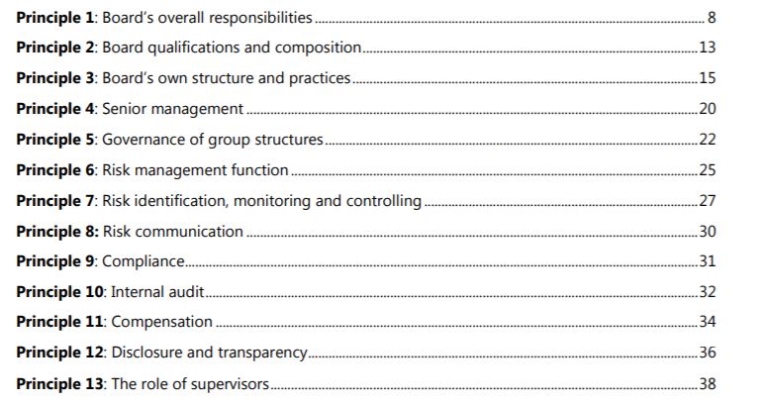
Basel Pillar II – Corporate governance (1/3)
BCBS 328

Slide 26
Basel Pillar II – Corporate governance (2/3)
IE1.5
Principle 1: Board’s overall responsibilities
The board has overall responsibility for the bank, including approving and overseeing management’s implementation of the bank’s strategic objectives, governance framework and corporate culture.
Principle 2: Board qualifications and composition
Board members should be and remain qualified, individually and collectively, for their positions. They should understand their oversight and corporate governance role and be able to exercise sound, objective judgment about the affairs of the bank.
Principle 3: Board’s own structure and practices
The board should define appropriate governance structures and practices for its own work, and put in place the means for such practices to be followed and periodically reviewed for ongoing effectiveness.
Principle 4: Senior management
Under the direction and oversight of the board, senior management should carry out and manage the bank’s activities in a manner consistent with the business strategy, risk appetite, remuneration and other policies approved by the board.
Principle 5: Governance of group structures
In a group structure, the board of the parent company has the overall responsibility for the group and for ensuring the establishment and operation of a clear governance framework appropriate to the structure, business and risks of the group and its entities.
Principle 6: Risk management function
Banks should have an effective independent risk management function, under the direction of a chief risk officer (CRO), with sufficient stature, independence, resources and access to the board.

Slide 27
Basel Pillar II – Corporate governance (3/3)
IE1.5
Principle 7: Risk identification, monitoring and controlling
Risks should be identified, monitored and controlled on an ongoing bank-wide and individual entity basis. The sophistication of the bank’s risk management and internal control infrastructure should keep pace with changes to the bank’s risk profile, to the external risk landscape and industry practice.
Principle 8: Risk communication
An effective risk governance framework requires robust communication within the bank about risk, both across the organisation and through reporting to the board and senior management.
Principle 9: Compliance
The bank’s board of directors is responsible for overseeing the management of the bank’s compliance risk. The board should establish a compliance function and approve the bank’s policies and processes for identifying, assessing, monitoring and reporting and advising on compliance risk.
Principle 10: Internal audit
The internal audit function should provide independent assurance to the board and should support board and senior management in promoting an effective governance process and the long-term soundness of the bank.
Principle 11: Compensation
The bank’s remuneration structure should support sound corporate governance and risk management.
Principle 12: Disclosure and transparency
The governance of the bank should be adequately transparent to its shareholders, depositors, other relevant stakeholders and market participants

Slide 28
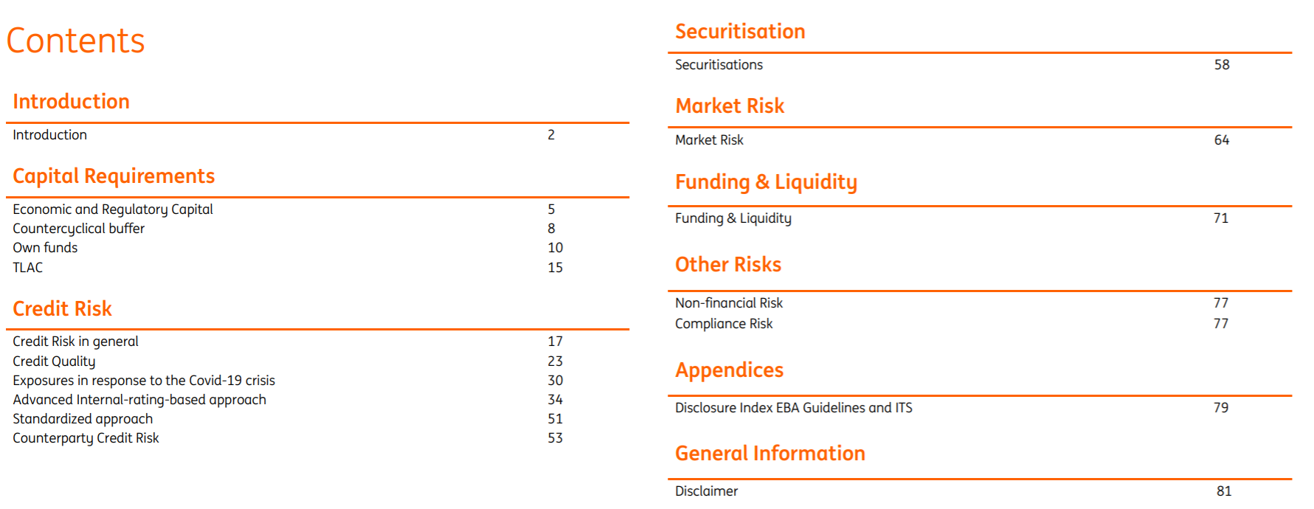
Basel Pillar III - Disclosure

Slide 29
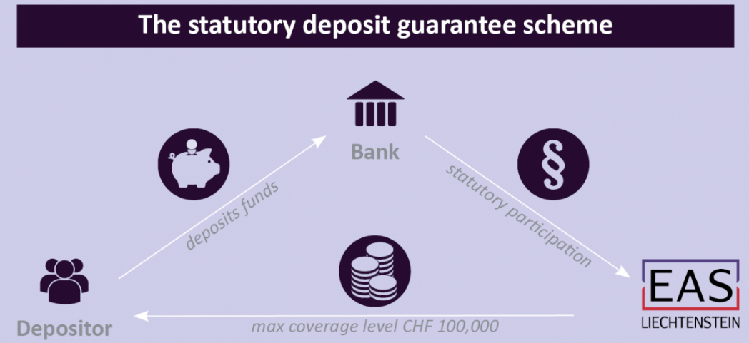
Deposit insurance
Banks obliged to pay for deposit insurance = > Dr Charge of insurance premium (Loss) | Cr Cash
Quarterly charge of insurance premium = simple average of deposits (retail and corporate) * 0.12%*
Coverage level in Russia for retail and corporate => 1.4 mln.rub. In particular cases may be increased up to 10 mln.rub.
State insurance agency
*Actual on 03.08.2022 for all types of deposits

Slide 30
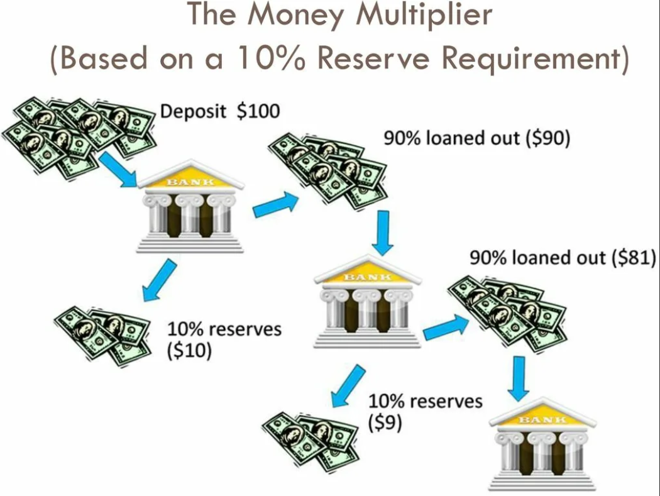
Reserve requirements
Banks obliged to freeze a percentage of deposits as reserves in a Central bank account = > Dr Balance with central bank | Cr Cash
Balance with central bank = deposit * coefficient based on the type of deposit*
So, to grant a 100 rub loan, a bank needs to attract a 104.2 (=100/0.96) rub deposit
*4% for deposits in rubles, 8% for deposits in FX

Slide 31
1.4 Foundations of risk management
Influence of cognitive biases on the occurrence of risk and risk management

Slide 32
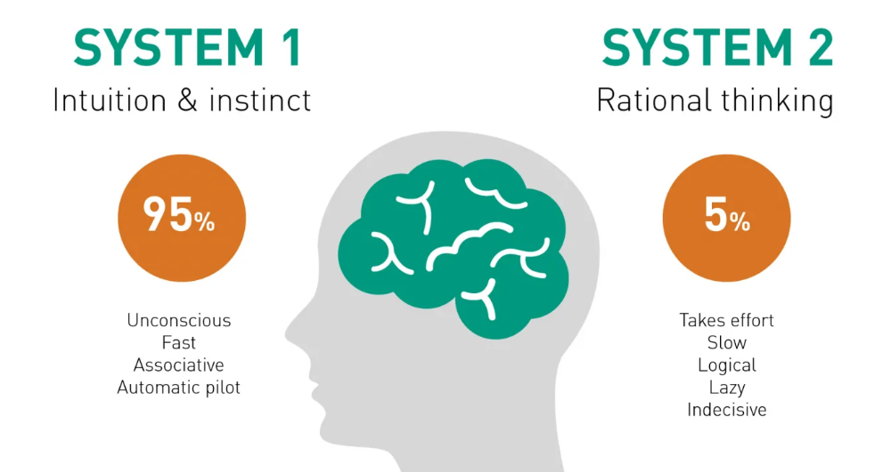
Cognitive bias
The notion of cognitive biases was introduced by Amos Tversky and Daniel Kahneman in 1972
Tversky and Kahneman explained human differences in judgment and decision-making in terms of heuristics.
Heuristics involve mental shortcuts which provide swift estimates about the possibility of uncertain occurrences.
Heuristics are simple for the brain to compute but sometimes introduce "severe and systematic errors."
System 1 tasks:
determine that an object is at a greater distance than another
localize the source of a specific sound
display disgust when seeing a gruesome image
drive a car on an empty road
understand simple sentences
System 2 tasks:
direct your attention towards someone at a loud party
try to recognize a sound
determine the appropriateness of a particular behavior in a social setting
park into a tight parking space
determine the validity of a complex logical reasoning
solve 17 × 24

Slide 33
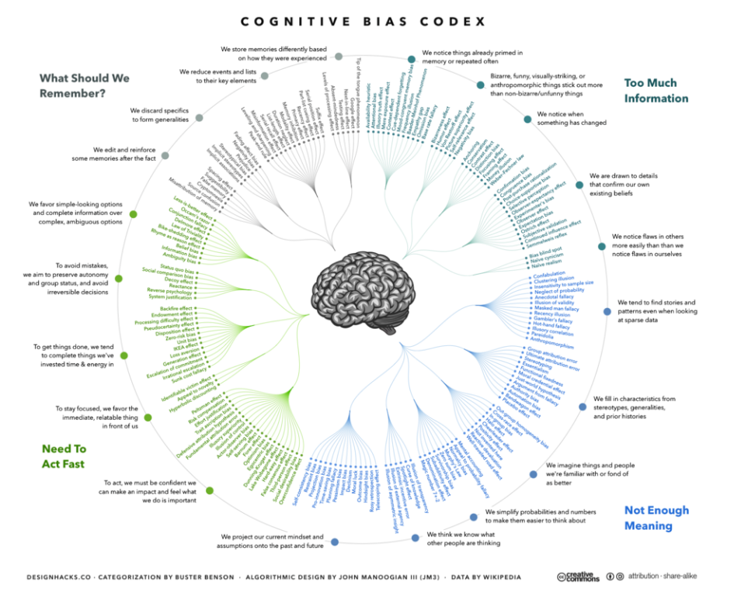
Taxonomy of cognitive biases

Slide 34
Too much information
Name of Bias | Description
Availability heuristic | The availability heuristic operates on the notion that if something can be recalled, it must be important/frequent, or at least more important/frequent than alternative solutions which are not as readily recalled
Illusory truth effect | The tendency to believe false information to be correct after multiple repetition
Base rate fallacy | People tend to ignore the base rate in favor of the individuating information
Anchoring | An individual's decisions are influenced by a particular reference point or 'anchor'
Confirmation bias | The tendency to search for, interpret, favor, and recall information in a way that confirms or supports one's prior beliefs or values

Slide 35
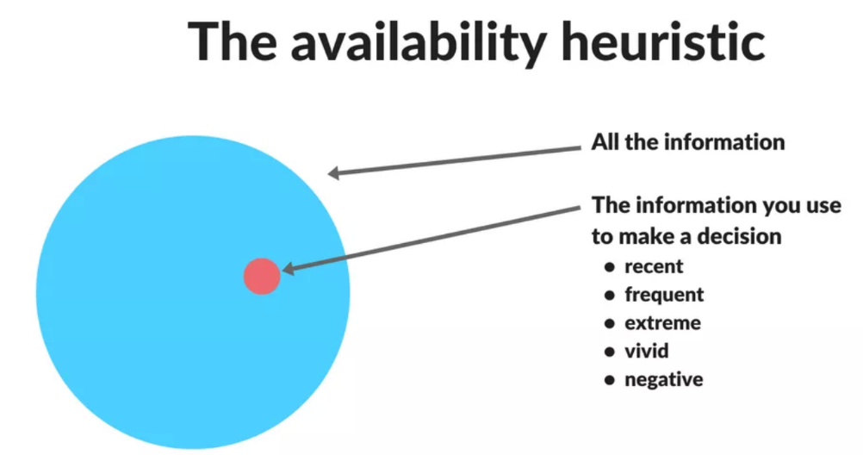
Availability heuristic
Insurance Rates
After natural disasters, it has been observed that related insurance rates spike in affected communities.
Since it is easier to recall the experience of a disaster that occurred recently, community members are likely to overestimate the risk of a repeated event in the years immediately following the disaster.
Winning the Lottery
The probability of winning the Powerball jackpot lottery is approximately 1 in 300 million.
However, given that it is easier to bring to mind images of lottery winners than lottery losers, it is subconsciously believed that winning the lottery is far more likely than it actually is.
Influence on risk management process:
- Not enough data (coverage or/and depth)
- Omissions in decision making (overestimate recent crises, underestimate distant ones and hardly consider something which never happens)

Slide 36
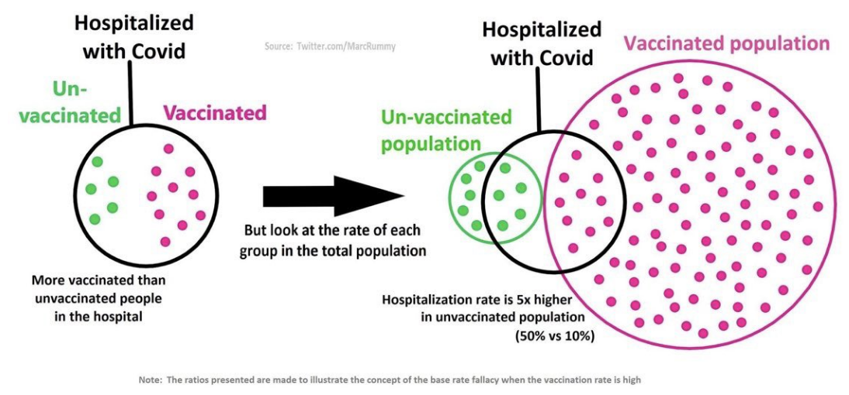
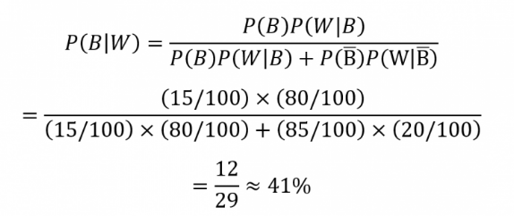
Base rate fallacy
IE1.2
85% of cabs in a city are blue and the rest 15% are white. One night, a cab is involved in a hit and run accident.
A witness claims the cab was white, however later tests show that they only correctly identify the color of the cab at night 80% of the time.
Base rate = Prior probability that car involved in accident is white ~ 15%
Posterior probability that car involved in accident is white if witness indicated so ~ 41%

Slide 37
Anchoring
The anchoring effect does not always have negative effects. Using an anchor is nature’s way of helping human beings arrive at results.
Anchoring bias helped you arrive close to the answer. Our brain uses anchors to make a calculated guess on the answers we do not know for sure.
Influencing Factors:
Mood
Personality
Experience
40 320

Slide 38
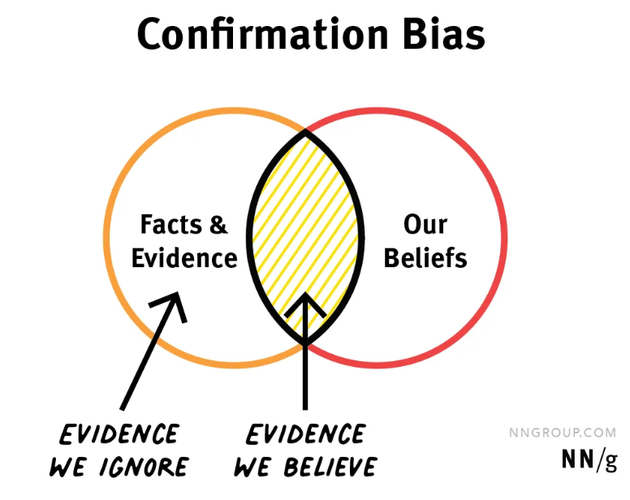
Confirmation bias
“extrasensory perception” example
Someone believing in extrasensory perception (ESP) will keep close track of instances when they were 'thinking about Mom, and then the phone rang and it was her!' Yet they ignore the far more numerous times when (a) they were thinking about Mom and she didn't call and (b) they weren't thinking about Mom and she did call.
Information Processing:
Confirmation bias serves as an efficient way to process information because of the limitless information humans are exposed to.
Protect Self-esteem:
People are susceptible to confirmation bias to protect their self-esteem (to know that their beliefs are accurate). To make themselves feel confident, they tend to look for information that supports their existing belief.

Slide 39
Not enough meaning
Name of Bias | Description
Neglect of probability | The tendency to disregard probability when making a decision under uncertainty and is one simple way in which people regularly violate the normative rules for decision making. Small risks are typically either neglected entirely or hugely overrated. The continuum between the extremes is ignored
Fundamental attribution error | The tendency for people to under-emphasize situational and environmental explanations for an individual's observed behavior while overemphasizing dispositional- and personality-based explanations.
Authority bias | The tendency to attribute greater accuracy to the opinion of an authority figure (unrelated to its content) and be more influenced by that opinion
Not invented here | The tendency to avoid using or buying products, research, standards, or knowledge from external origins. It is usually adopted by social, corporate, or institutional cultures.
Planning fallacy | The phenomenon in which predictions about how much time will be needed to complete a future task display an optimism bias and underestimate the time needed

Slide 40
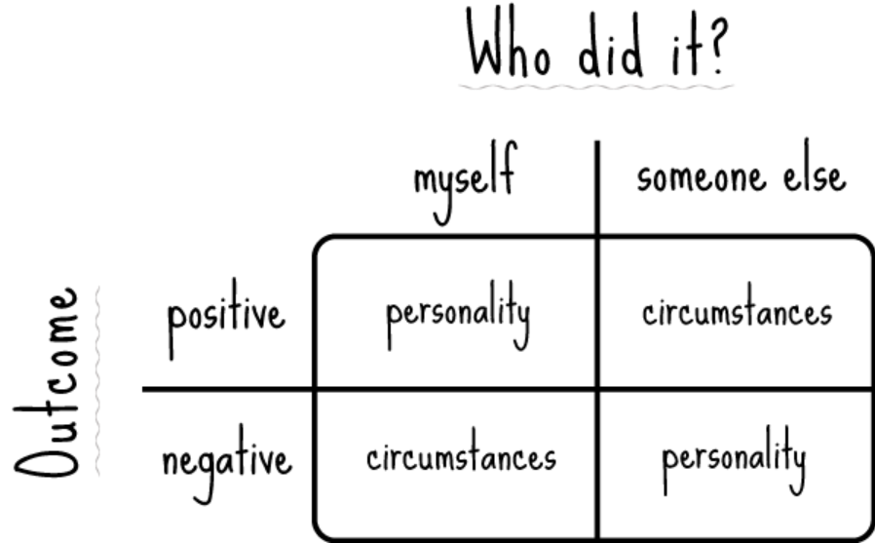
Fundamental attribution error

Slide 41
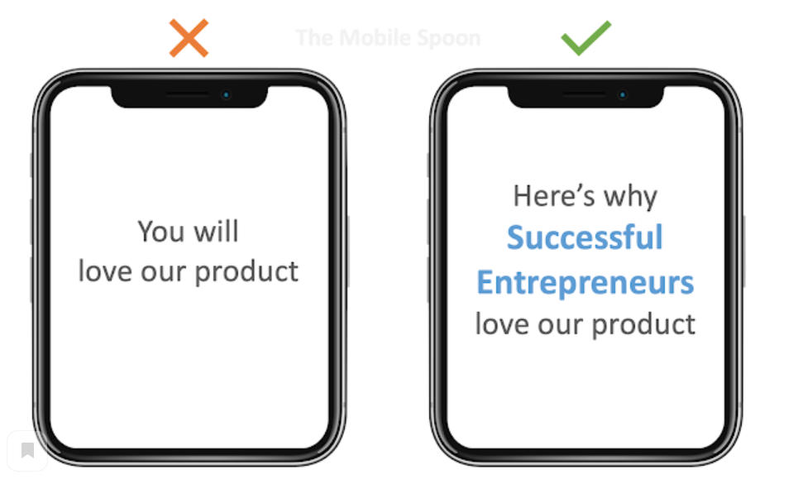
Authority bias

Slide 42
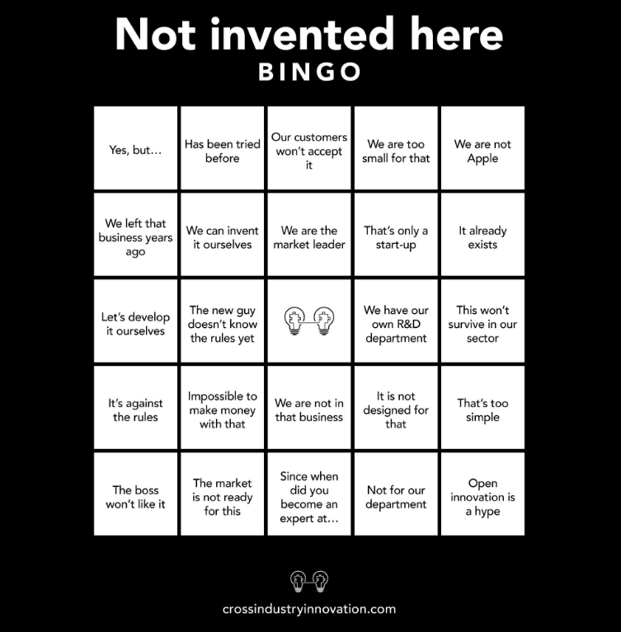
Not invented here
According to an article by David Antons and Frank T. Piller of RWTH Aachen University, two key conditions must exist to identify the presence of the syndrome:
a boundary of knowledge between two entities
an irrational devaluation of external knowledge.
The experimenters concluded that once we feel like we’ve created an idea, a sense of ownership is established and we begin to overvalue the usefulness and importance of that idea. In other words, we can form irrational and unhealthy attachments to our own ideas.

Slide 43
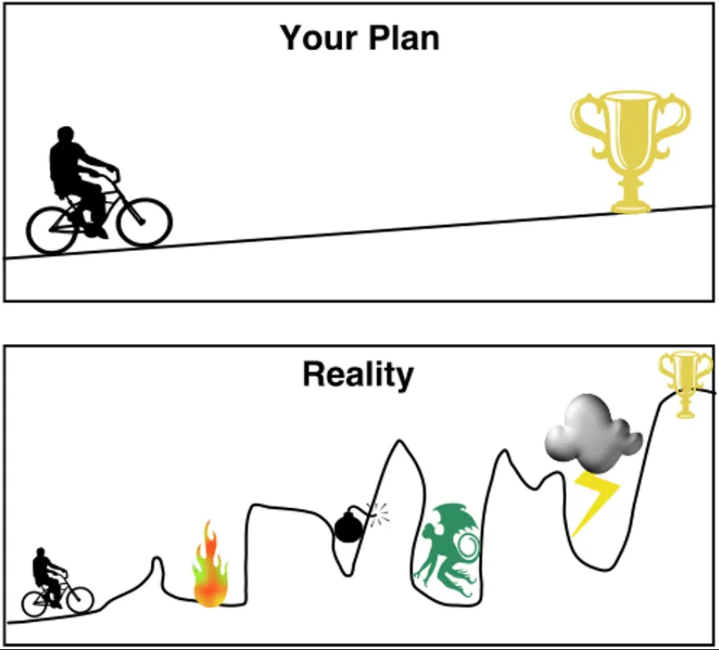
Planning fallacy
In a 1994 study, 37 psychology students were asked to estimate how long it would take to finish their senior theses. The average estimate was 33.9 days.
They also estimated how long it would take "if everything went as well as it possibly could" (averaging 27.4 days) and "if everything went as poorly as it possibly could" (averaging 48.6 days).
The average actual completion time was 55.5 days, with only about 30% of the students completing their thesis in the amount of time they predicted.
Another study asked students to estimate when they would complete their personal academic projects. Specifically, the researchers asked for estimated times by which the students thought it was 50%, 75%, and 99% probable their personal projects would be done
13% of subjects finished their project by the time they had assigned a 50% probability level;
19% finished by the time assigned a 75% probability level;
45% finished by the time of their 99% probability level.

Slide 44
Need to act fast
Name of Bias | Description
Illusion of control | The tendency for people to overestimate their ability to control events.
Risk compensation | The theory which suggests that people typically adjust their behavior in response to perceived levels of risk, becoming more careful where they sense greater risk and less careful if they feel more protected
Escalation of commitment | Human behavior pattern in which an individual or group facing increasingly negative outcomes from a decision, action, or investment nevertheless continue the behavior instead of altering course
Loss aversion | the tendency to prefer avoiding losses to acquiring equivalent gains

Slide 45
Illusion of control
You are probably falling prey to this illusion anytime you think your actions influence an event outside your individual control, for example:
Engaging in rituals: For example, wearing a specific lucky item or participating in rituals to ensure that your favorite team wins a game.
Dwelling on regrets: Sometimes, people will ruminate over past events because they mistakenly believe they could have controlled or changed the outcome.
Risky behaviors: People who think they are in control of events may be more likely to engage in risky behaviors.
Magical thinking: When people try to make something happen through force of will (i.e., trying to direct the events with their own thoughts), they tend to attribute the outcome to their own thought
Factors which increase the likelihood of this illusion:
Type of feedback: When people receive feedback emphasizing success, they are more likely to feel they are in control. When feedback focuses on failure, however, people tend to feel less in control of the situation.
Familiarity: When people are very familiar with a situation and outcome, it is more common to experience an illusion of control.
Emotional involvement: This phenomenon is stronger when people have an emotional investment in what happens.
Mood: The effect is lessened among people who have depression. Depressed people are more likely to make negative judgments about their ability to influence what happens.²
Performance: Doing well at the beginning of a task often leads people to think they have more control than they actually do.

Slide 46
Escalation of commitment
Drivers:
Project
High costs of ending a project or changing its course, potential financial gain upon completion, and extensive structure can factor in to escalation of commitment, making it difficult to walk away from the project.
Psychological
Optimism and belief that one has control over what will still be positive outcomes lead to continued self-justification of commitment to actions.
Social
Group identity or cohesive strength has been found to have the most influence on escalation of commitment while public evaluation of decision and resistance to decision from others has little significance in relation.
Structural
Structural determinants are those that refer to the cultural and environmental features and resources of the project's overall organization. The minimal research available on them indicates that agency problems most influence escalation of commitment.
The actor maintains behaviors that are irrational, but align with previous decisions and actions, for example:
An advance-fee scam - involves promising the victim a significant share of a large sum of money, in return for a small up-front payment. If a victim makes the payment, the fraudster either invents a series of further fees for the victim to pay or simply disappears.
After a heated and aggressive bidding war, property developer Robert Campeau ended up buying Bloomingdale's for an estimated $600 million more than it was worth. In 1992, The Wall Street Journal wrote regarding the bidding war that "we're not dealing in price anymore but egos." Campeau was forced to declare bankruptcy soon afterwards.
30–40% of software projects experience escalation of commitment due to their complexity and uncertainty. Intangibility makes determining the current status of projects especially difficult

Slide 47
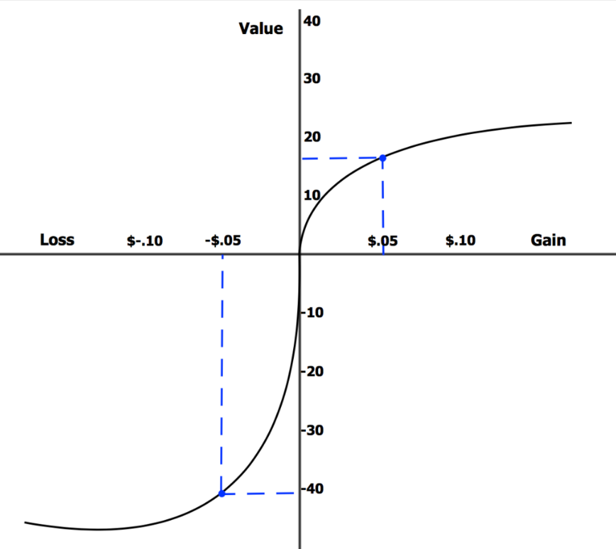
Loss aversion
“The response to losses is stronger than the response to corresponding gains” is Kahneman’s definition of loss aversion. “Losses loom larger than gains” meaning that people by nature are aversive to losses. Loss aversion gets stronger as the stakes of a gamble or choice grow larger.
Which option do you choose:
Option A – $0 with a probability of 10%,$1300 with a probability of 60% and $1500 with a probability of 30%
or
Option B – a guaranteed $1000
Mat expectation of option A: 1500*30%+1300*60%+0*10%=1230 > 1000
Humans are theorized to be hardwired to be loss averse due to asymmetric evolutionary pressure on losses and gains: "for an organism operating close to the edge of survival, the loss of a day's food could cause death, whereas the gain of an extra day's food would not cause an extra day of life".

Slide 48
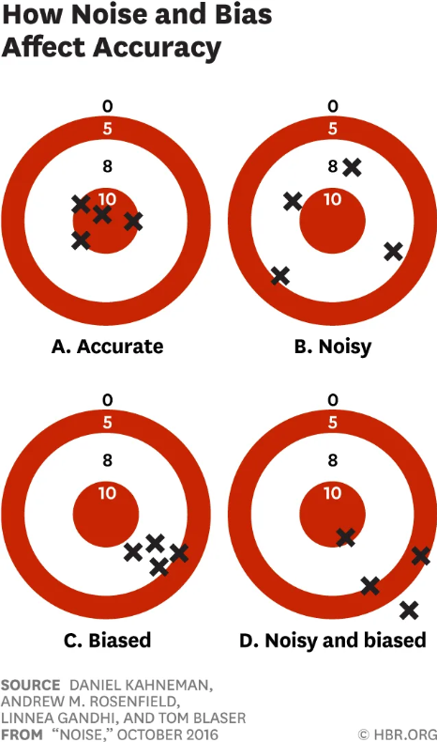
Bias vs Noise
Wherever there is a judgment, there is noise – and more of it than you think
Humans objective ignorance affects not only on ability to predict events but even our capacity to understand them
Why is noise rarely considered as an important problem?
Is a Guideline of any sort is effective to reduce noise?

Slide 49
I strongly recommend you watch a conversation between
of Daniel Kahneman and Yuval Noah Harari:
https://www.youtube.com/watch?v=7yhg7NmTeVg

