Slide 1
2.1 Foundations of Credit risk management
Definition and types of credit risk
Concept of expected and unexpected loss

Slide 2
Definition of credit risk
Credit risk is the possibility of a loss resulting from a borrower's failure to repay a loan or meet contractual obligations.
Examples:
Unwillingness to pay because of any reasons (bankruptcy, legal claim to the bank, other)
Overdue payments
Concession with discount
Restructuring:
Write-off of any outstanding balance (principal, interest, commission, fines other balances)
Payment holidays
Decrease of interest rate on Loan as consequence of financial problems of the borrower

Slide 3
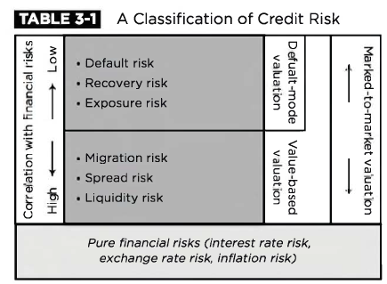
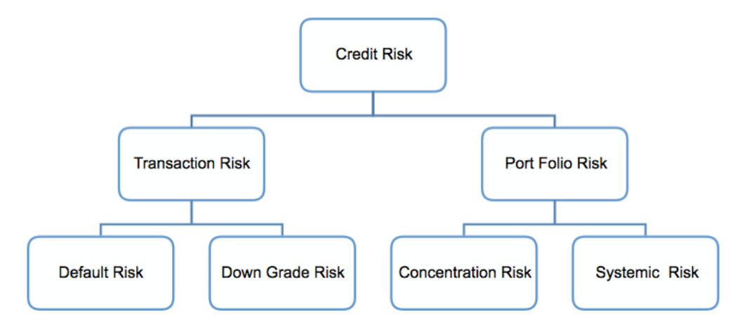
Types of credit risk
Credit default risk – The risk of loss arising from a debtor being unlikely to pay its loan obligations in full or the debtor is more than 90 days past due on any material credit obligation; default risk may impact all credit-sensitive transactions, including loans, securities and derivatives.
Concentration risk – The risk associated with any single exposure or group of exposures with the potential to produce large enough losses to threaten a bank's core operations. It may arise in the form of single-name concentration or industry concentration.
Country risk – The risk of loss arising from a sovereign state freezing foreign currency payments (transfer/conversion risk) or when it defaults on its obligations (sovereign risk); this type of risk is prominently associated with the country's macroeconomic performance and its political stability.
OR

Slide 4
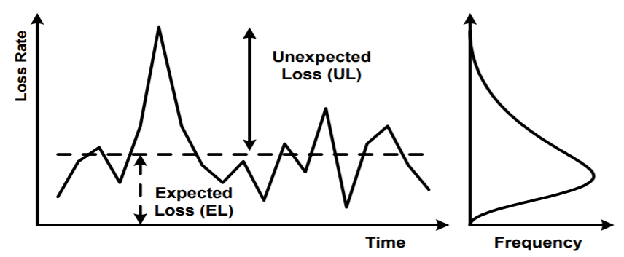
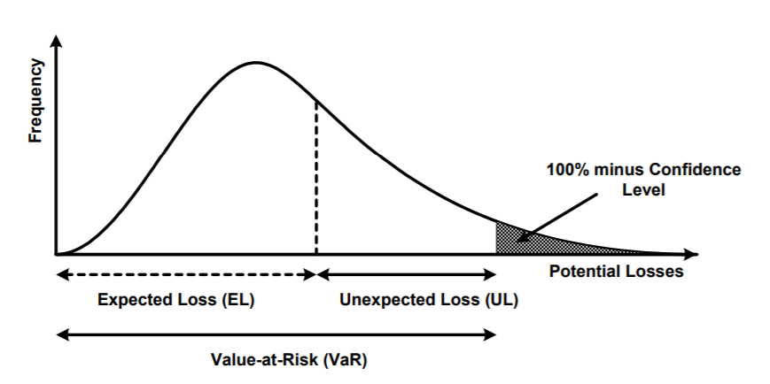
Concept of Expected and Unexpected loss (make a table)
Expected loss is:
- Unbiased assessment of the loss during “average” year => IFRS 9, regulatory provisions, EL for IRB
- Loss in terms of PL => affect capital directly
Unexpected loss is:
- Conservative assessment of the loss during economic downturn => RWA (IRB approach or standardized approach)
- Obligation for banks to held enough capital to absorb unexpected loss
Potential loss:
- 100% loss has vanishingly small probability and bank should not able to survive such type of loss

Slide 5
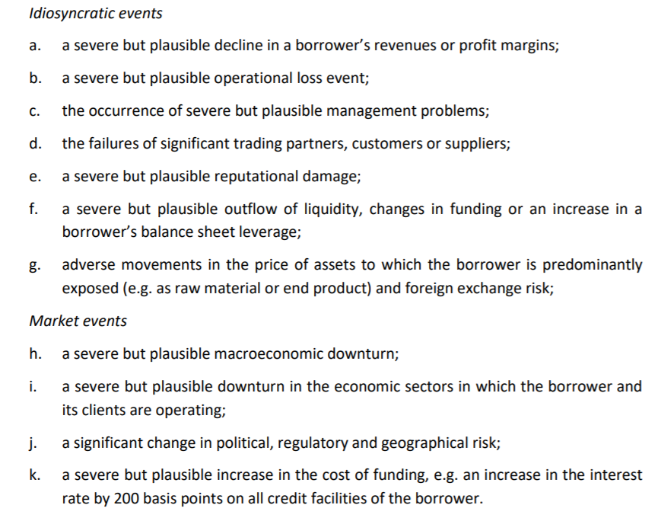
Idiosyncratic vs Systematic risk

Slide 6
2.2 Loan loss provision
IFRS 9 and regulatory provisions
Role in business processes
Calculation techniques

Slide 7
IFRS 9 – credit risk calculation framework for both IFRS and MIS*
Definition of impairment (loss in IFRS and MIS) under IFRS 9:
“The difference between all contractual cash flows that are due to an entity in accordance with the contract and all the cash flows that the entity expects to receive, discounted at the original effective interest rate.”
An entity shall measure expected credit losses of a financial instrument in a way that reflects:
an unbiased and probability-weighted amount that is determined by evaluating a range of possible outcomes;
the time value of money
reasonable and supportable information that is available without undue cost or effort at the reporting date about past events, current conditions and forecasts of future economic conditions.
* IFRS – international financial reporting standards, MIS – management information system

Slide 8
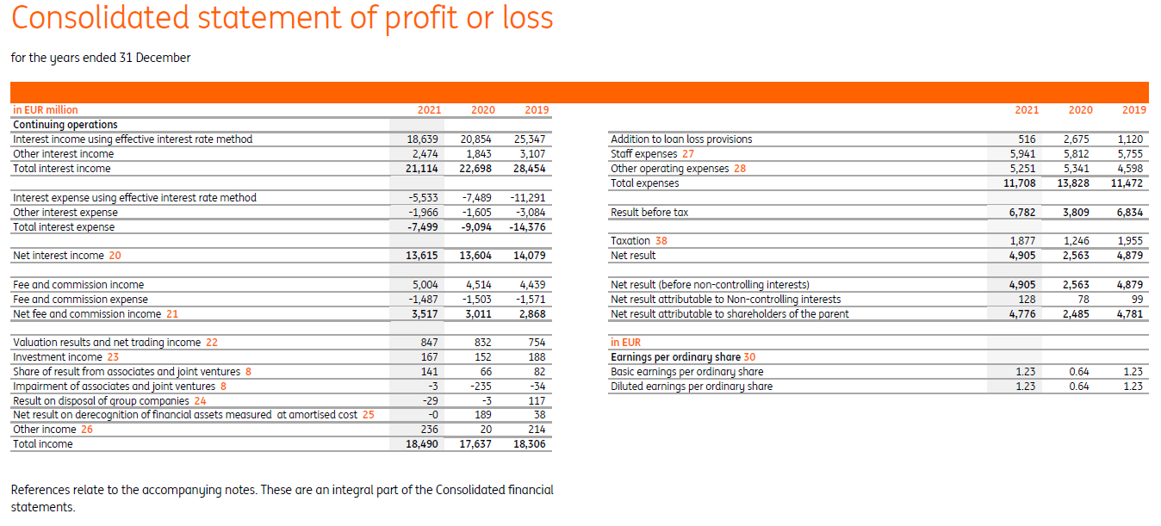
IFRS 9 provisions in reporting
IFRS 9 provisions applied in:
MIS (management information system)
Dividends and management remuneration
IFRS reporting

Slide 9
IFRS 9 – calculation framework
IE2.1
∑
ECL
=
PD
x
LGD
x
EAD
x
Discount factor
Expected credit loss = provision in IFRS 9 reporting
Best estimate loss prediction on loan portfolio
Probability of default on 12m or on period of lifetime
Can be marginal or cumulative
Measure of creditworthiness
PIT calibration
Loss given default
Mainly the measure of quality of the collateral
Exposure at default
Prediction of outstanding balance on the date of default – repayment of current debt and origination of new debt
Discount factor based on effective interest rate of the loan

Slide 10
IFRS 9 – staging and default definition
Stage 1 - ECL 12 m
Stage 2 - ECL Lifetime
Stage 3 - ECL Lifetime
High credit quality
Significant increase in credit risk (SICR) since initial recognition
Default
№ | Stage 2 criterias | Description
1. | Overdue 30+ days | Overdue of any payment on 30+ or more days => borrower in default. Problems to consider: materiality threshold; FIFO vs LIFO
2. | Significant shift of PD | Increase of PD since initial recognition 2 or 3 times Problems to consider: low credit risk assets; different stage for different contracts of one borrower
3 | Other criteria | Breach of covenants, delay of the contract, conflict between beneficiaries/top management, significant shift in relevant macro factors, significant decrease of revenue,
№ | Stage 3 criterias | Description
1. | Overdue 90+ days | Overdue of any payment on 90+ or more days => borrower in default.
2. | Default restructuring | Restructuring because client cannot service it’s debt: decrease interest rate or payment holidays or transfer of payments to the end of the contract period
3. | Bankruptcy | Bank issued bankruptcy claim on borrower or borrower proclaim itself a bankrupt
4. | Other criteria | Cession with discount, write off, legal cases, other

Slide 11
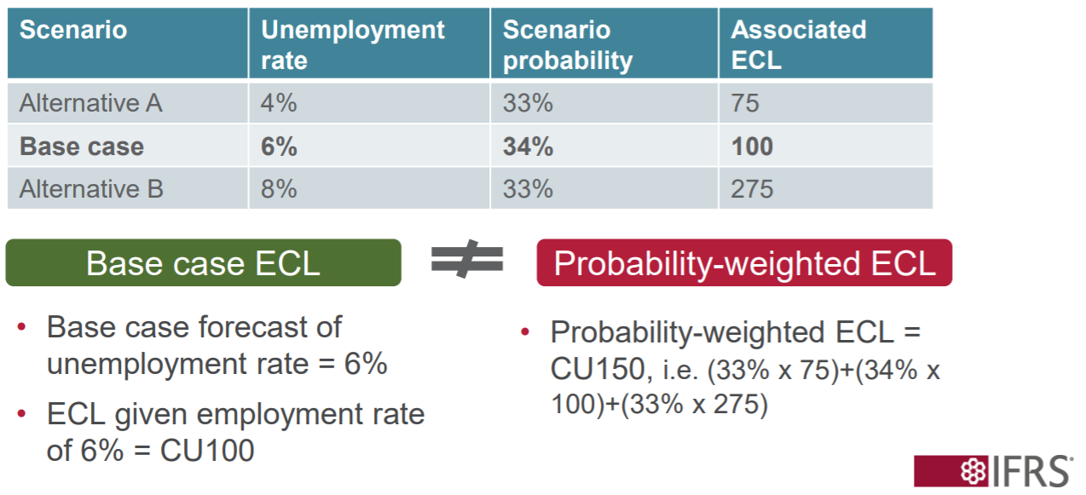
IFRS 9 – forward-looking information
The objective of the impairment requirements is to recognise lifetime expected credit losses for all financial instruments for which there have been a [SICR]…….considering all reasonable and supportable information, including that which is forward looking (para 5.5.4 of IFRS 9)

Slide 12
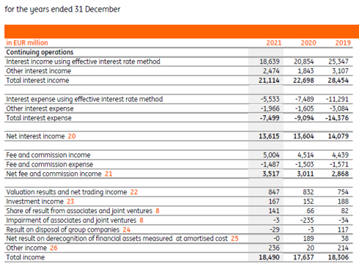
CVA
PR
IE 2.1
Credit valuation adjustment (CVA) is the difference between the risk-free portfolio value and the true portfolio value that takes into account the possibility of a counterparty's default
Unilateral CVA is given by the risk-neutral expectation of the discounted loss. The risk-neutral expectation can be written as:
CVA is included in value of derivatives=>
$$CVA=\int_{0}^{T}{EPE∗LGD∗mPD}$$
EPE – expected positive exposure
LGD – LGD of the client
mPD – marginal PD of the counterparty

Slide 13
Prudential provisions (590-П)
Methodology for corporate borrowers
Debt service | Creditworthiness (category) = > provision rate
 | Good | Average | Bad
Good | Standard (I category) => 0 % | Sub standard (II category) => 1-20% | Doubtful (III category) => 21-50%
Average | Sub standard (II category) => 1-20% | Doubtful (III category) => 21-50% | Problematic (IV category) => 51-99%
Bad | Doubtful (III category) => 21-50% | Problematic (IV category) => 51-99% | Hopeless (V category) => 100%
$Prudential provision=prov. rate from range×balance+min prov. rate per category$ $×offbalance$
Debt service:
Overdue
Restructuring
Sources of repayment
Creditworthiness:
Internal ratings
or
Qualitative and quantitative metrics (slide 29)
Prudential provisions applied in:
Taxation
CAR calculation
RSA reporting

Slide 14
2.3 Capital adequacy ratio and RWA on credit risk
CAR – general considerations
RWA on credit risk - STD and IRB approaches

Slide 15
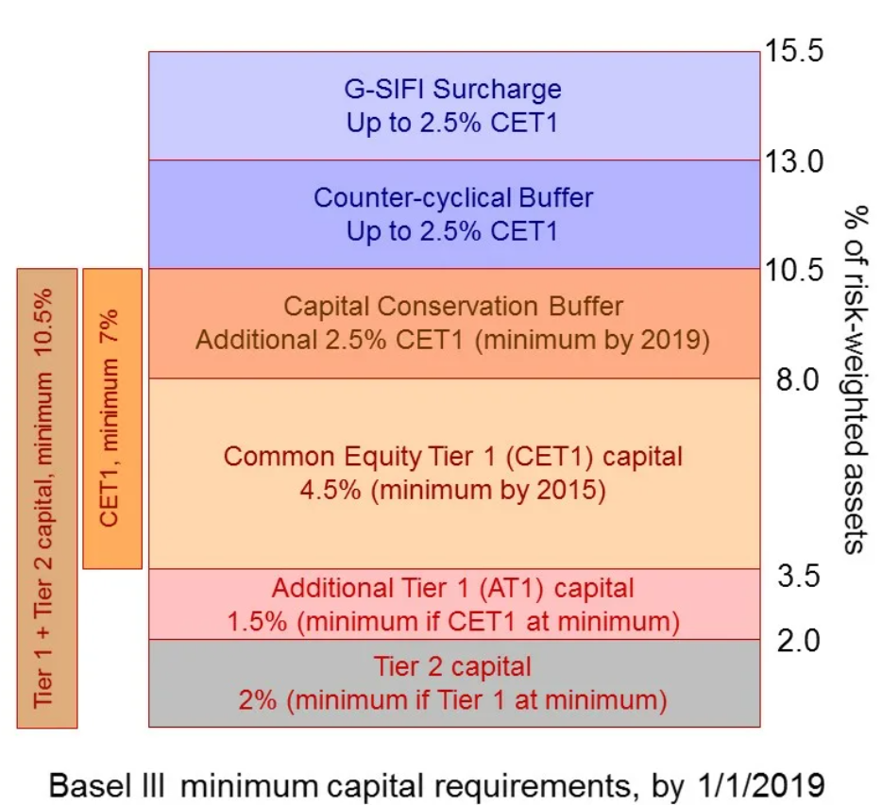
Capital adequacy ratio (1/2)¹
IE2.2
Tier 1 (going concern) | Common Equity Tier 1 (CET1) | Sum of common shares (equivalent for non-joint stock companies* ) and stock surplus, retained earnings, other comprehensive income, qualifying minority interest and regulatory adjustments | (Н1.1) $\frac{CET 1}{RWA}$ > 4.5%
 | Additional Tier 1 (AT1) | Sum of capital instruments meeting the criteria for AT1 and related surplus, additional qualifying minority interest and regulatory adjustments | (Н1.2) $\frac{CET 1+AT1}{RWA}$ > 6%
Tier 2 (gone concern) |  | Sum of capital instruments meeting the criteria for Tier 2 and related surplus, additional qualifying minority interest, qualifying loan loss provisions and regulatory adjustments | (Н1.0) $\frac{CET 1+AT1+Tier 2}{RWA}$> 8%
Allowances used to regulate dividends:
Maintaining capital adequacy = 2.5%
Countercyclical buffer = 0%
Systematically important banks =1%
RWA = Credit risk + Market risk + operational risk
¹https://www.bis.org/fsi/fsisummaries/defcap_b3.pdf
Criteria mentioned in the table above - https://www.bis.org/publ/bcbs189.pdf and 199-И for Russian specifics

Slide 16
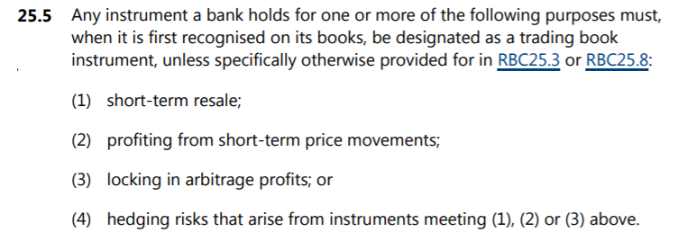
Scope for RWA on Credit risk – banking and trading book
Base for calculation of RWA on credit risk is banking book
Trading book | Banking book
(1) instruments held as accounting trading assets or liabilities; (2) instruments resulting from market-making activities; (3) equity investments in a fund excluding those assigned to the banking book in accordance with [RBC25.8]; (4) listed equities; (5) trading-related repo-style transaction; (6) options including embedded derivatives from instruments that the institution issued out of its own banking book and that relate to credit or equity risk. | (1) unlisted equities; (2) instruments designated for securitisation warehousing; (3) real estate holdings, where in the context of assigning instrument to the trading book, real estate holdings relate only to direct holdings of real estate as well as derivatives on direct holdings; (4) loans; (5) equity investments in a fund, unless the bank meets at least one of the following conditions: (a) the bank is able to look through the fund to its individual components and there is sufficient and frequent information, verified by an independent third party, provided to the bank regarding the fund’s composition; (b) the bank obtains daily price quotes for the fund and it has access to the information contained in the fund’s mandate or in the national regulations governing such investment funds; (6) hedge funds; (7) derivative instruments and funds that have the above instrument types as underlying assets; or (8) instruments held for the purpose of hedging a particular risk of a position in the types of instrument above.
https://www.bis.org/bcbs/publ/d457.pdf

Slide 17
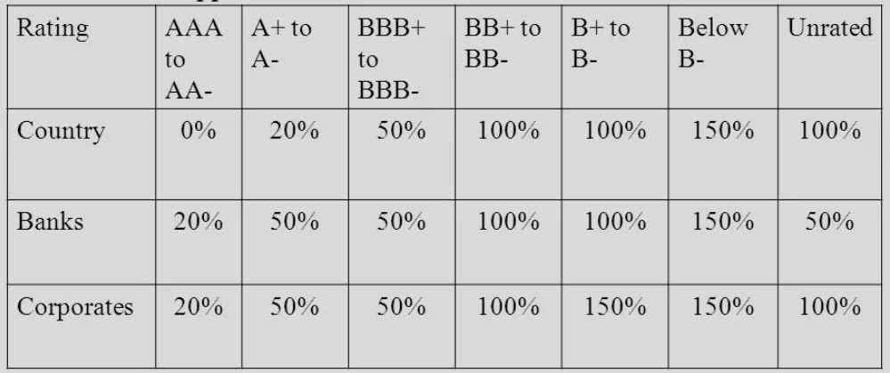
RWA on Credit risk – STD approach
Concept of RW on STD approach
$${RWA}_{std}=\left(Assets −Prudential provisions\right)∗{RW}_{std}$$

Slide 18
RWA on Credit risk - IRB calculations (1/2)
$${RWA}_{irb}={RW}_{irb}×EAD$$
PD
LGD
M
R
$${RW}_{irb}$$
f (
=
)
Probability of default
12month horizon
calibrated through the cycle (TTC)
Loss given default
LGD foundation – 40% adjusted on collateral;
LGD advanced – model assessment
Remaining term of the contract
Correlation
Depend on asset class and its systemic risk
Foundation IRB
Advanced IRB
$${IRB}_{rw}=12,5\left(Ф\left[\frac{Ф^{−1}\left(PD\right)+\sqrt{R}∙Ф^{−1}\left(0,999\right)}{\sqrt{1−R}}\right]∙LGD−PD∙LGD\right)∙\frac{1+\left(M−2,5\right)∙b}{1−1,5∙b}$$
$${IRB}_{rw}=12,5\left(Ф\left[\frac{Ф^{−1}\left(PD\right)+\sqrt{R}∙Ф^{−1}\left(0,999\right)}{\sqrt{1−R}}\right]∙LGD−PD∙LGD\right)$$

Slide 19
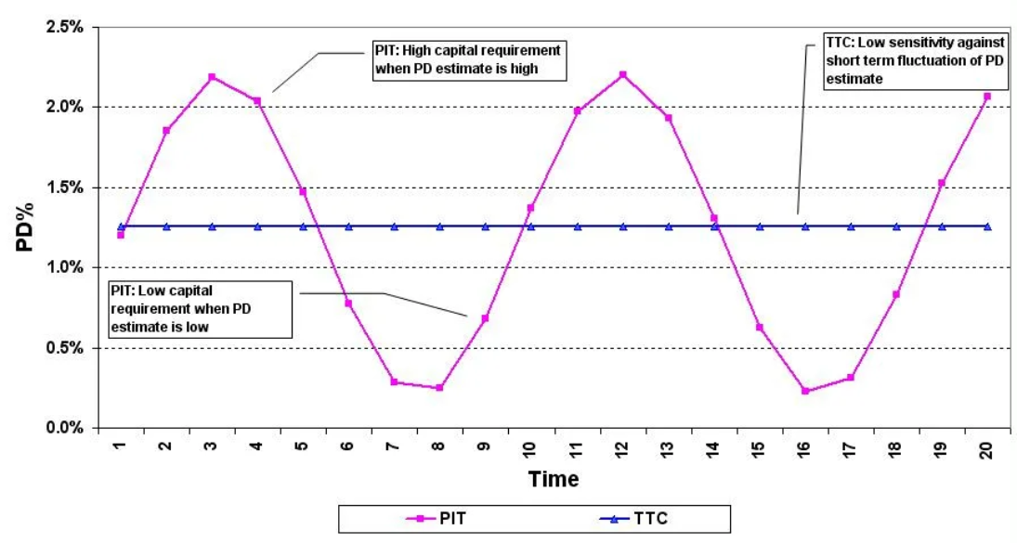
PIT vs TTC calibration
DR = $\frac{Number of defaults during the period}{Number of non defaults at the begining of the period}$

Slide 20
RWA on Credit risk - IRB calculations (2/2)
IE2.2
1. Not default
2. Default
$${IRBК}_{rw}=12,5\left(Ф\left[\frac{Ф^{−1}\left(PD\right)+\sqrt{R}∙Ф^{−1}\left(0,999\right)}{\sqrt{1−R}}\right]∙LGD−PD∙LGD\right)∙\frac{1+\left(M−2,5\right)∙b}{1−1,5∙b}$$
$${IRB}_{rw}=max⁡(0;100\%−rate of prudential provisions)$$
Segment
Formula for R
LGD
Other corporates
$$R=0,12\left(\frac{1−e^{−50∙PD}}{1−e^{−50}}\right)+0,24\left(1−\frac{1−e^{−50∙PD}}{1−e^{−50}}\right)$$
40%
Financial organizations
$$R=1,25 \left[0,12\left(\frac{1−e^{−50∙PD}}{1−e^{−50}}\right)+0,24\left(1−\frac{1−e^{−50∙PD}}{1−e^{−50}}\right)\right]$$
45%
SME
$$R=0,12\left(\frac{1−e^{−50∙PD}}{1−e^{−50}}\right)+0,24\left(1−\frac{1−e^{−50∙PD}}{1−e^{−50}}\right) \\ −0,04×\left(1−\frac{S−0,1L}{0,9L}\right)$$
40%
S – annual revenue of borrower, L – limit on revenue 209-ФЗ (120 mln/ 800 mln/ 2 bln)
Special lending
$$R=0,12\left(\frac{1−e^{−50∙PD}}{1−e^{−50}}\right)+0,3\left(1−\frac{1−e^{−50∙PD}}{1−e^{−50}}\right)$$
40%
Or Basel slotting
SL class | Level of creditworthiness
 | BBB- и выше | BB+/ BB | BB- / B+ | от B до C | Default
HVCRE | 95% | 120% | 140% | 250% | 100%-PP
IPRE, PF, CF, OF | 70% | 90% | 115% | 250% | 100%-PP

Slide 21
Capital burden generated by loans - EL and UL
PR – loophole in regulations

Slide 22
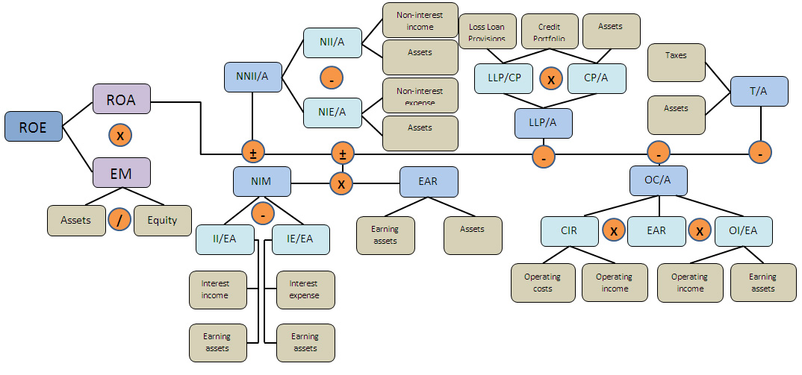
Credit risk benchmarks
IE 1.3
1

Slide 23
Difference between IFRS 9 and IRB
Section | IRB | IFRS 9
Metric affected (PL or capital) | Amount of necessary capital | Profit & loss
Type of loss (EL or UL) | UL | EL
Approach to calculations (conservative or best estimate) | Conservative | Unbiased and probability weighted
Model calibration (PIT or TTC) | TTC | PIT
Horizon of loss assessment | Non-default – 1 year Default – constant or modeled LGD | 1st stage – 1 year 2nd and 3rd stage - lifetime
Is professional judgment applicable? (yes or no) | No | Yes
Is forward looking information implemented? (yes or no) | No | Yes
Default definition | Best practice is to have unified definition of default

Slide 24
2.4 Credit risk models
Steps of model development
Common structure of PD and LGD models
Common risk factors of PD and LGD models
Model calibration
Model validation

Slide 25
Common steps of model development:
Data preparation
Single factor analysis
Model development
Calibration
Negotiations with stakeholders
Independent validation
Supervisory approval

Slide 26
1. Data preparation
LGD
PD
LGD def
1.1 Define target variable
1.2 Modeling sample:
Product/segment
Period and frequency of the slices
Division of the sample on train, test and validation subsamples
Sources of data and other
1.3 Data cleansing:
Missed data (delete, change on average, interpolate by some another factor)
High level data analysis (descriptive statistics, analysis of the trends, histograms, matrices of migration)
Transformation of variables (smoothing, accounting of seasonal factor, woe (weight of evidence) transformation, logit transformation and others)
PD 30+
LGD sec
PD 60+
EAD

Slide 27
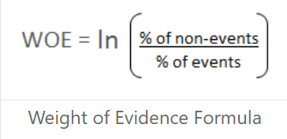
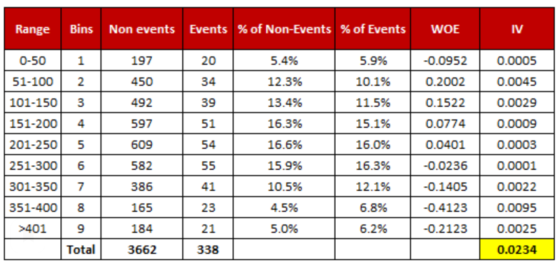
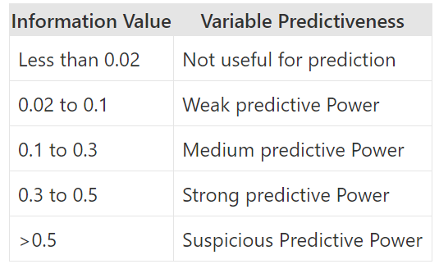
1.3 Data cleansing
IE2.3
WOE:
treat outliers
handles categorical variable so there is no need for dummy variables
helps you to build strict linear relationship with log odds.
IV:
Easy way to evaluate predictive power
Applicable only to binary logistic regression
Logit transformation
IV thresholds
Exponential smoothing

Slide 28
2. Single factor analysis
Long-list
Short-list
How do we perform it?:
Single factor regressions -> evaluating of predictive power of each factor (Gini and IV)
Correlation analysis

Slide 29
3. Model development
The most common PD model => Logistic regression
The most common LGD model => Decision tree
Advantages of these models:
simple to design and implement
easy to interpret
relatively high performance

Slide 30
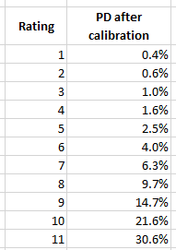
3. PD model corporate
Quantitative module
Qualitative module
Credit history
Warning signals (overdue, conflict in top management and etc)
Support of the group/beneficiary
Support of the government
Collateral
Manual adjustments
Final Rating =>PD
Calibration
Score
Factors of quantitative module:
Revenue,
Debt / Equity,
Debt / EBITDA,
Revenue / average assets and etc.
Factors of qualitative module:
Change of the beneficiaries,
Quality of management,
Overdue on tax payments and etc.

Slide 31
3. Factors for risk metrics models - corporate
1. Information on the purpose of the loan
2. Where relevant, evidence of the purpose of the loan
3. Financial statements and accompanying notes on single entity and consolidated levels (balance sheet, profit or loss, cash flow) covering a reasonable period, audited or professionally verified accounts, where applicable
4. Aged debtor reports/statements
5. Business plan both for the borrower and in relation to the purpose of the loan
6. Financial projections (balance sheet, profit or loss, cash flow)
7. Evidence of tax status and tax liabilities
8. Data from credit registers or credit information bureaux, covering at least the information on financial liabilities and arrears in payment
9. Information on the borrower’s external credit rating, where applicable
10. Information on existing covenants and the borrower’s compliance with them, where relevant
11. Information on major litigations involving the borrower at the time of application
12. Information on the collateral, if any
13. Evidence of ownership of the collateral, where applicable
14. Evidence of the value of the collateral
15. Evidence of insurance of the collateral
16. Information on the enforceability of the collateral (in the case of specialised lending, a description of the structure and security package of the transaction)
17. Information on guarantees, other credit risk mitigating factors and guarantors, if any
18. Information on ownership structure of the borrower for the purposes of AML/CFT
https://www.eba.europa.eu/sites/default/documents/files/document_library/Publications/Guidelines/2020/Guidelines%20on%20loan%20origination%20and%20monitoring/884283/EBA%20GL%202020%2006%20Final%20Report%20on%20GL%20on%20loan%20origination%20and%20monitoring.pdf

Slide 32
3. PD model retail
Application model
Behavioral model
Score
Rating
Factors of application model:
credit history bureau information, legal disputes, behavioral data on current clients and etc
Age, education, sex, working experience, region, Profit-to-income and etc
Factors of behavioral model:
Share of max overdue amount over last n months
Quantity of overdue payments over last n months
Ratio of current debt to initial debt and etc.
Calibration
Data from open source or partners (mobile operator, gas station, retail, social networks and etc)

Slide 33
3. Factors for risk metrics models - retail
1. Evidence of identification
2. Evidence of residence
3. Where applicable, information on the purpose of the loan
4. Where applicable, evidence of eligibility for the purposes of the loan
5. Evidence of employment, including the type, sector, status (e.g. full-time, part-time, contractor, self-employed) and duration
6. Evidence of income or other sources of repayment (including annual bonus, commission, overtime, where applicable) covering a reasonable period, including payslips, current bank account statements, and audited or professionally verified accounts (for self-employed persons)
7. Information on financial assets and liabilities, e.g. savings account statements and loan statements indicating outstanding loan balances
8. Information on other financial commitments, such as child maintenance, education fees and alimonies, if relevant
9. Information on household composition and dependants
10. Evidence of tax status
11. Where applicable, evidence of life insurance for the named borrowers
12. Where applicable, data from credit registers or credit information bureaux or other relevant databases, covering the information on financial liabilities and arrears in payment
13. Information on the collateral, if any
14. Evidence of ownership of the collateral
15. Evidence of the value of the collateral
16. Evidence of insurance of the collateral
17. Information on guarantees, other credit risk mitigating factors and guarantors, if any
18. Rental agreement or evidence of potential rental income for buy-to-let loans, if any
19. Permissions and cost estimates, if applicable, for real estate building and improvement loans
https://www.eba.europa.eu/sites/default/documents/files/document_library/Publications/Guidelines/2020/Guidelines%20on%20loan%20origination%20and%20monitoring/884283/EBA%20GL%202020%2006%20Final%20Report%20on%20GL%20on%20loan%20origination%20and%20monitoring.pdf

Slide 34
4. Calibration
IE 2.3
Goal of calibration is to convert score into risk metric (PD, LGD, CCF or any other)
Nature of calibration is optimization task for searching of parameters of the model under some constraints.
In case of PD model, it is searching of β0 and β1 of logistic regression with 2 constraints:
Factual DR is equal to average PD on calibration sample
Minimization of square error between factual DR across ratings and PD assigned to ratings after calibration

Slide 35
3. LGD model
IE 2.3
Realized LGD = $\frac{Balance at default −Recovery∗Discount factor}{Balance at default}$
LGD model
Probability of outcomes
Level of loss across outcomes
Cost of collection
Factor of economic downturn
Duration in default, share of repaid principal and LTV
LGD in default model
Potential outcomes of the default:
Recovery
Concession
Write off
Foreclosure on collateral
Discounting rate:
EIR (effective interest rate) on agreement
Average rate on loans originated at the beginning of default

Slide 36
6. Validation – general framework
IE 2.4
Types | Description
Initial | Conducted before implementation of the model
Monitoring | Conducted monthly or quarterly Only key and standardized test Fail of monitoring is a trigger for unplanned regular validation
Regular | Conducted annually; All tests calculated, high depth of analysis
Validation
Qualitative
Quantitative
Evaluation of documents
Discriminatory power
Evaluation of methodology
Accuracy of calibration
IT validation
Stability
Validation of quality of the data
Reasonableness and applicability evaluation

Slide 37
2.5 Model development, calibration and validation
Credit risk management tools
Role of credit committee
Risk appetite and business planning metrics
Risk of concentration

Slide 38
Credit Risk management tools
IE 2.5
IE 2.6
Accept:
Thresholds on risk metrics or some other metrics
Limits
Share:
Insurance
Joint products
Control:
Reporting (watch list/warning signals and etc.)
Risk appetite limits and business planning
Mitigate:
Rejection
Collateral
Covenants
Loan origination strategy

Slide 39
Credit committee
A credit committee is a group of executives who meet to make decisions and vote on loan approval.
This committee is usually established by the bank's board of directors and consist of:
Members with vote: risks, business, security, legal,
Members without vote: compliance, finance, treasury, collateral
The main task of this committee is to agree or refuse on granting a particular loan, based on following information:
Business plan and projected CF of the client (Quantitative analysis) - risks, business
Industry risk, market risk (Qualitative analysis) - risks, business
Expected PL on deal – finance, treasury
Risks of optionalities (explicitly and implicitly embedded derivatives) - finance, treasury
Legal review of contract - legal
Know your client (KYC) check - security
Compliance check (sanctions, tax regime, other specific legal limitations) - compliance
Evaluation of collateral/guarantees - collateral
Integral assessment of abovementioned risks on the deal - risks
Other function is approval of automated loan strategies (cut offs, routing of the deals, pricing and etc)

Slide 40
Risk appetite limits (KPI for risk) and business planning risk metrics (KPI for business)
LLP/CP (in roe tree) = Cost of risk (CoR) = $\frac{Additions to loan loss provision per period}{Average loans per period}$
Provision for loan impairment ratio (PLI ratio) = $\frac{Loan loss provision on date}{Loans on date}$
Non performing loans ratio (NPL ratio) = $\frac{Loans in default on date}{Loans on date}$
0+ overdue ratio = $\frac{Loans with overdue 0+ on date}{Loans on date}$
RWA density on credit risk = $\frac{RWA generated by loans on date}{Loans on date}$
RoRWA or RAROC or ROE = $\frac{Risk adjusted return}{Capital (regulatory or economical or share capital)}$
On example of CoR:
If breached:
0,5%
Business plan limits
Consider revision of business plan and calibration of loan strategy
0,7%
Yellow risk appetite limit
Inform board of directors and perform actions
1,5%
Red risk appetite limit
Inform regulator and provide remediation plan

Slide 41
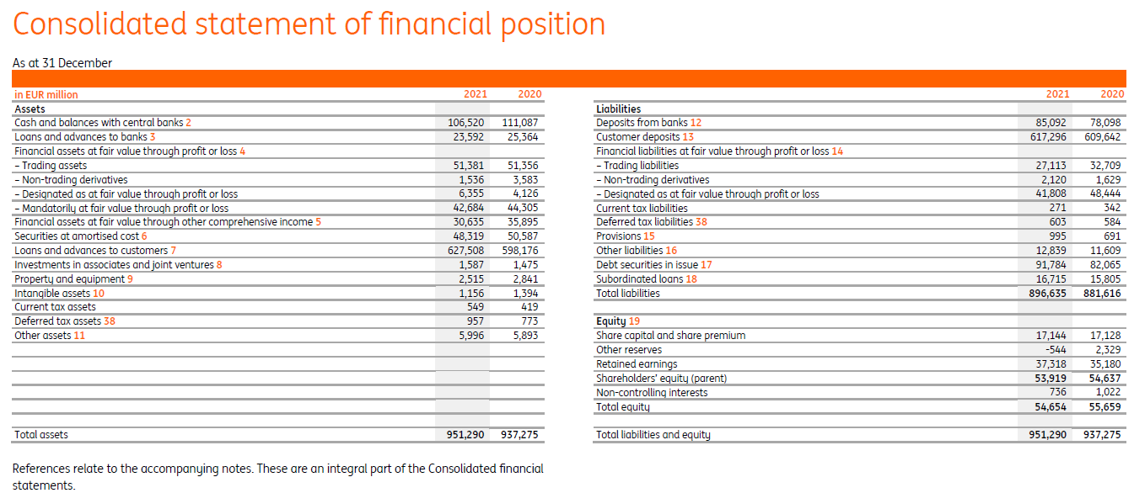
Introduction to banking finance – Balance sheet of the Bank
IE1.1

Slide 42
Introduction to banking finance – P&L of the Bank
IE1.1

Slide 43
Risk of concentration
Theory Practice
EBA GL recommends to assess and manage concentration risk in:
Credit risk
Market risk
Operational risk
History shows that concentration of credit risk in asset portfolios has been one of the major causes of bank distress. This is true both for institutions and banking systems at large.
The failures of large borrowers like Enron, Worldcom and Parmalat were the source of sizeable losses in few banks.
Concentration of exposures in credit portfolios may arise from two types of imperfect diversification.
relates to imperfect diversification of idiosyncratic risk in the portfolio either because of its small size or because of large exposures to specific individual obligors.
relates to imperfect diversification across systematic components of risk, namely sectoral factors
Banks typically focus on concentration risk in Credit risk.
Widespread indicators of concentration risk:
Informational metrics:
Herfindahl-Hirschman Index (HHI) calculated based on customer, industries, countries,
Share of portfolio on top 3, 5, 10, 20 customers
Regulatory limits:
Regulatory ratio on concentration of credit risk (Н6 in Russia): $\frac{Outstanding amount on largest group in credit portfolio}{Tier 1 + Tier 2 capital}$ <=25%
Treated as a significant risk in ICCAP on which ECAP need to be reserved. The most simple methodology => “hard” default of average top N borrower.

Slide 44
Loan origination strategy – Corporate portfolio
1. Specification of geographical markets and economic sectors
2. Customer acceptance criteria, i.e. for specific PDs, external ratings, customer types, track record, etc.
3. Minimum requirements for revenues, cash flow and financial projections
4. Minimum requirements for collateral
5. Minimum requirements for guarantees and credit enhancements
6. Minimum requirements for acceptable covenants
7. Requirements for the drawdown of the loan to the borrower
8. Maximum loan amounts
9. Appropriate limits on partial recourse or non-recourse loans
10. Maximum loan maturities
11. Amortisation schedules and standards for the acceptability of and limits on non-amortising loans and on the use of interest reserves and cash sweep structures
12. Risk-based limits (towards concentration, type of product, etc.)
13. Acceptable loan-to-value ratio limits (for secured lending)
14. Acceptable debt-servicing coverage ratio limits
15. Acceptable interest coverage ratio limits
16. Acceptable EBITDA limits
17. Acceptable leverage ratio limits
18. Acceptable debt-to-equity ratio limits 19. Acceptable loan-to-cost ratio limits 20. Acceptable cash-flow-to-debt-service ratio limits 21. Acceptable return on equity ratio limits 22. Acceptable capitalisation rate (net operating income/market value) limits 23. Standards to address and mitigate risks associated with environmental risk 24. Compliance policy with macroprudential requirements, when relevant

Slide 45
Loan origination strategy – Retail portfolio
1. Customer acceptance criteria, i.e. customer types, customer age limits, customer credit record, PD
2. Definition of acceptable income
3. Minimum requirements for collateral
4. Minimum requirements for guarantees
5. Maximum loan amounts
6. Maximum loan maturities
7. Amortisation requirements (including interest rate type for the loans)
8. Risk-based limits (concentration, type of product, etc.)
9. Acceptable loan-to-value ratio limits (for secured lending)
10. Acceptable loan-to-income ratio limits
11. Acceptable debt-to-income ratio limits
12. Acceptable income-to-total-credit-obligation ratio limits (including for gross income, income after taxes and premiums, income after financial expenses, income after regular other expenses)
13. Acceptable maximum size of loan to repayment capacity
14. Compliance policy with macroprudential requirements, when relevant
https://www.eba.europa.eu/sites/default/documents/files/document_library/Publications/Guidelines/2020/Guidelines%20on%20loan%20origination%20and%20monitoring/884283/EBA%20GL%202020%2006%20Final%20Report%20on%20GL%20on%20loan%20origination%20and%20monitoring.pdf

Slide 46
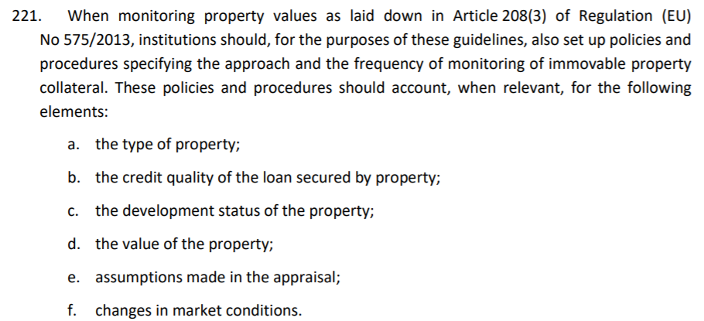
Collateral

