Slide 1
3.1 Foundations of market risk of trading book
Definition and types of market risk
Banking book and trading book
Instruments of Market risk management (limits, portfolio hierarchies and etc.)

Slide 2
Market risk - definition
Market risk is the risk of losses in positions arising from movements in market variables like prices and volatility.
The most used types of market risk are:
Interest rate risk, the risk that interest rates (e.g. Libor, Euribor, etc.) will change.
Equity risk, the risk that stock or stock indices (e.g. Euro Stoxx 50, etc.) prices will change.
Currency risk, the risk that foreign exchange rates (e.g. EUR/USD, EUR/GBP, etc.) will change.
Commodity risk, the risk that commodity prices (e.g. corn, crude oil) will change.

Slide 3
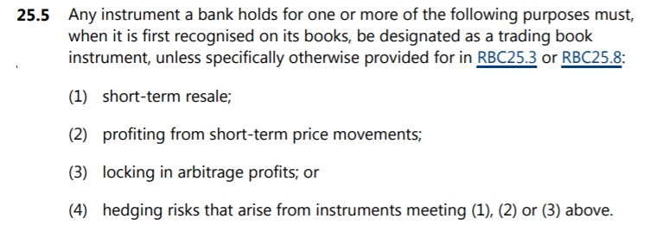
Banking and trading book
Properties | Banking book | Trading book
Objective of the position | Ordinary banking activity | Speculation
Term of the position | Held to maturity | Short term
Volume of the position | ≈95% of the balance | ≈5% of the balance
Type of financial result | Interest income | Revaluation
Trading book | Banking book
(1) instruments held as accounting trading assets or liabilities; (2) instruments resulting from market-making activities; (3) equity investments in a fund excluding those assigned to the banking book in accordance with [RBC25.8]; (4) listed equities; (5) trading-related repo-style transaction; (6) options including embedded derivatives from instruments that the institution issued out of its own banking book and that relate to credit or equity risk. | (1) unlisted equities; (2) instruments designated for securitisation warehousing; (3) real estate holdings, where in the context of assigning instrument to the trading book, real estate holdings relate only to direct holdings of real estate as well as derivatives on direct holdings; (4) loans; (5) equity investments in a fund, unless the bank meets at least one of the following conditions: (a) the bank is able to look through the fund to its individual components and there is sufficient and frequent information, verified by an independent third party, provided to the bank regarding the fund’s composition; (b) the bank obtains daily price quotes for the fund and it has access to the information contained in the fund’s mandate or in the national regulations governing such investment funds; (6) hedge funds; (7) derivative instruments and funds that have the above instrument types as underlying assets; or (8) instruments held for the purpose of hedging a particular risk of a position in the types of instrument above.
https://www.bis.org/bcbs/publ/d457.pdf

Slide 4
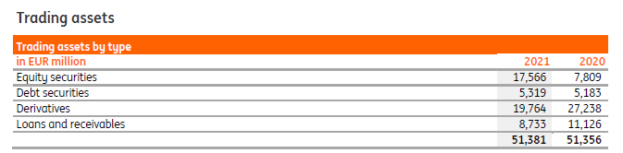
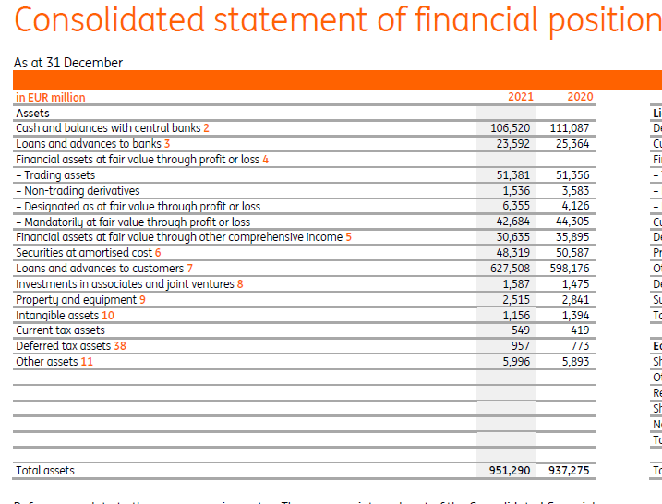

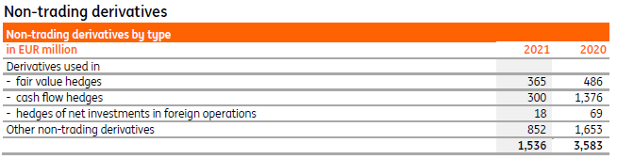
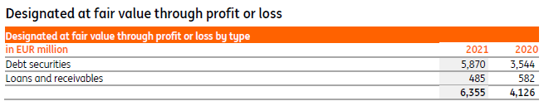
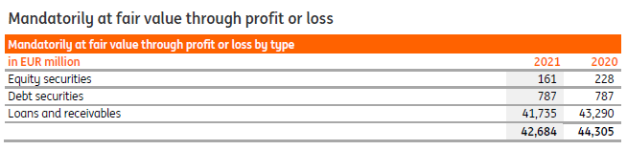
Market risk in banking BS
IE3.1

Slide 5
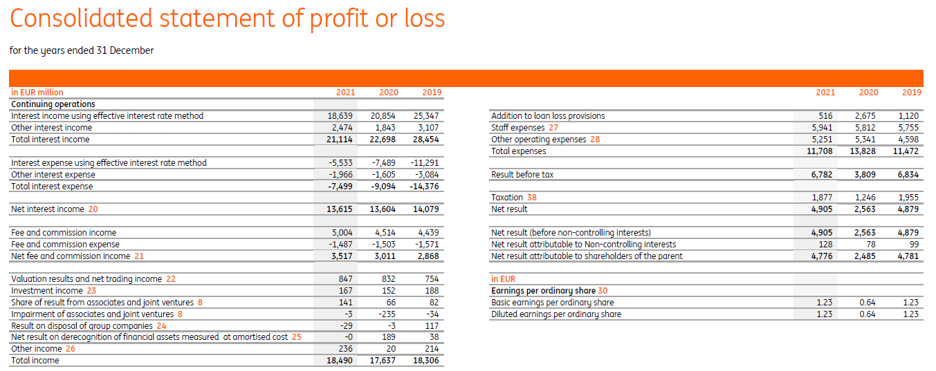
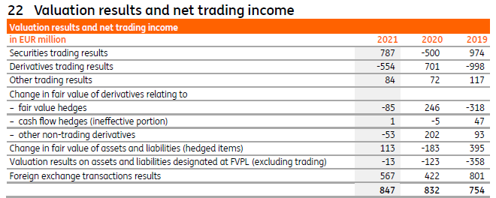
Market risk in banking PL
IE3.1

Slide 6
Financial instruments
  Ways of valuation
  Ways of settlement
Non-deliverable derivatives – payment of FV at expiration date
Physical delivery derivatives – delivery of the cash or commodity at expiration date
Publically available quotes
Internal valuation models
  Complexity
  Type of deals
Basic (investments in bonds, equities, commodities, FX)
Derivatives (spot, forwards, options, swaps, CDS and etc)
Exchange market - standardized contracts
OTC (over-the-counter) market – unique contracts

Slide 7
Market Risk management tools
Accept and mitigate:
  Elimination of market risk by making mirror deals (back-to-back) – conservative approach
  Limits – standard approach
  Capital requirements on market risk
Share:
  Hedging
Control:
  Reporting

Slide 8
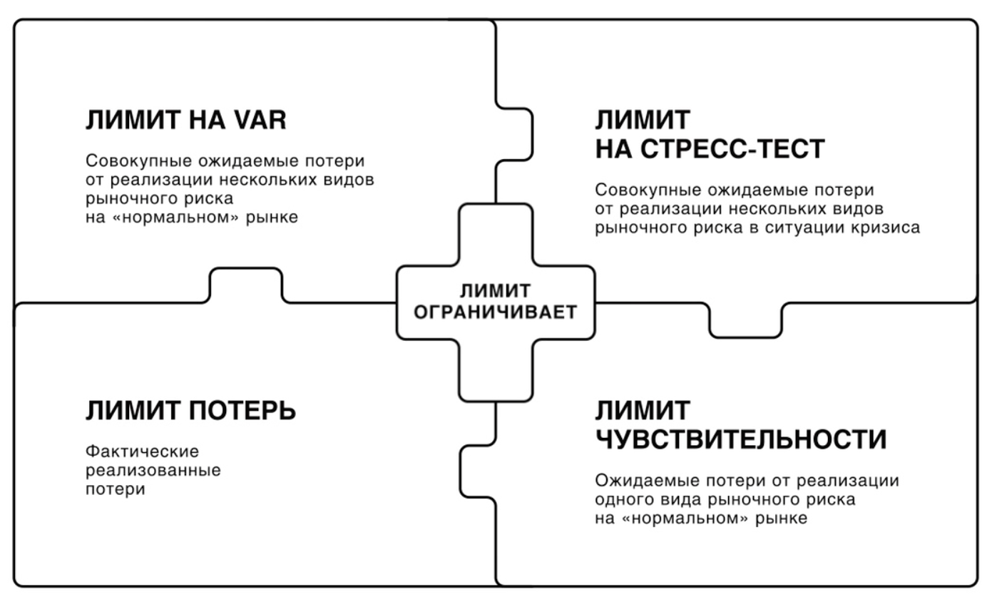

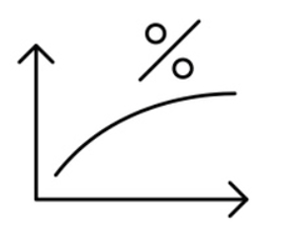
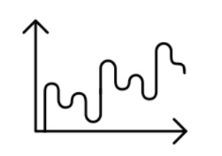

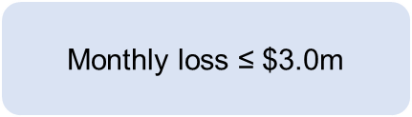

Types of limits
DELTA
1 day 95% VaR ≤ $ 4.0 m
Limits on sensitivities
Expected loss from realization of risk on “normal market” (analogue of EL in credit risk)
Limits on VaR
Total loss from realization of all associated market risks on “normal market” (analogue of EL + UL in credit risk)
DV01
VEGA
THETA
30
Purpose of limits – to limit positions
$\text{Daily} \text{loss}$ ≤ $2.0m
Rate USDRUR, EURRUR
Loss limits
Factual losses
Stress limits
Total loss from realization of all associated market risks at crisis (analogue of EL + UL in credit risk)
-20% -10% 0% 10% 20%
-3%
0%
3%
Volatility
$$\text{Loss}\text{ ≤}\text{ \$60}\text{m}$$
$\text{Monthly} \text{loss}$ ≤ $3.0m
8

Slide 9
Types of limits on sensitivities
DELTA
Sensitivity of portfolio FV to changes in quotes of underlying assets (FX, equity and etc.)
Underlying asset
GAMMA
Sensitivity of portfolio delta to changes in quotes of underlying assets
DV01
Sensitivity of portfolio FV to parallel shift in interest rate curve (on 1b.p.)
Interest rates
VEGA
Sensitivity of portfolio FV to changes in implied volatility (commonly vega calculated only for options)
Volatility
THETA
Sensitivity of portfolio FV to the passing of time (1day) with all other factors being equal
30
Time

Slide 10
Setting of limits
PR
Level of limits
Responsible authority
Portfolio hierarchy
Trading department
Desk 1
Portfolio 1
Desk 2
Portfolio 2
Portfolio 3
High level limits cascading to the lower levels
А
Main risk committee
Board of Directors
В
Committee on market risk
С
Market risk coordinator
Head of product line
D
Market risk coordinator
Head of portfolio

Slide 11
Structure of trading department - Desks
Name of Desk | Desk’s objective | Instruments
Equity desk | Trading profit and making ad hoc positions in interest of Business or Treasury Department | Shares, indexes, option on shares
Interest rate desk |  | Bonds, interest rate options
FX desk |  | Spot, forward and swaps on FX
Credit trading desk |  | Bonds, CDS
Commodity desk |  | Non deliverable Commodity derivatives
CVA desk | Hedging of CVA on FV instruments | All the above
Funding desk | Funding of trading book operations | REPO, Interbank, positions with Treasury department

Slide 12
Types of limits on sensitivities (2/2)
Net and gross positions per currencies | Delta | Gamma | DV01 | Vega | Theta
Bond | + | + | + | - | +
Equity | + | + | - | - | -
Index | + | + | - | - | -
Option on equity | + | + | + | + | +
Non delivery option on commodity | + | + | + | + | +
FX forward | + | + | - | - | +
FX swap | + | + | + | - | +
Interest rate swap | + | + | + | - | +
CDS | + | + | - | - | -

Slide 13
Monitoring of limits on sensitivities

Slide 14
3.2 VAR
VAR (value at risk) general definition
Assumptions
Calculations
Criticism

Slide 15
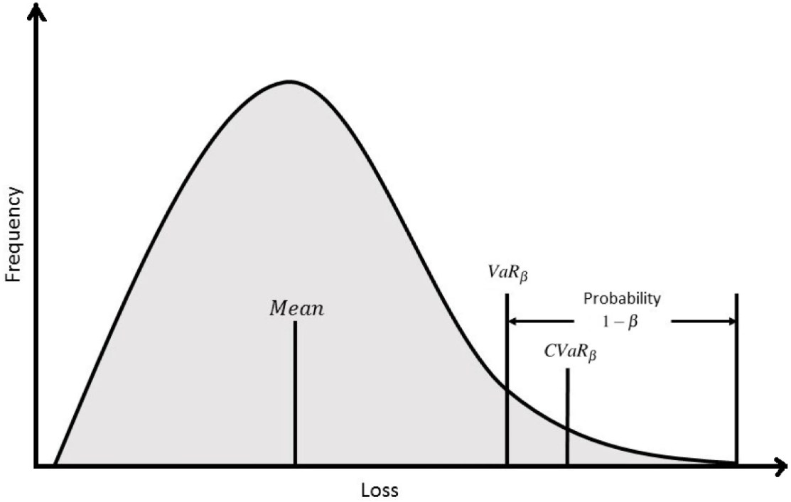
Value at risk (VaR)
IE3.2
Value at risk (VaR) estimates how much a set of investments might lose (with a given probability), given normal market conditions, in a set period such as a day.
For a given portfolio, time horizon, and probability (p), the VaR can be defined informally as the maximum possible loss during that time after excluding all worse outcomes whose combined probability is at most p.
For example, if a portfolio of stocks has a one-day 95% VaR of $1 million, that means that there is a 0.05 probability that the portfolio will fall in value by more than $1 million over one day if there is no trading.
CVAR conditional VAR if the loss is exceeded = Expected shortfall (ES) = average value at risk (AVaR) = expected tail loss (ETL)

Slide 16
VaR assumptions
There are five primary underlying assumptions for VaR:
1. Stationarity. A 1 percent fluctuation in returns is equally likely to occur at any point in time.
2. Random walk of intertemporal unpredictability. Day-to-day fluctuations in returns are independent.
3. Nonnegativity. Financial assets with limited liability cannot attain negative values.
4. Time consistency. All single-period assumptions hold over the multiperiod time horizon.
5. Distributional. Daily return fluctuations follow a normal distribution with a mean of zero and a standard deviation of 100 bp.

Slide 17
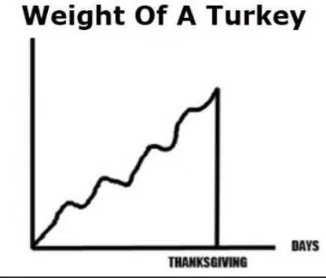
VaR criticism
https://www.youtube.com/watch?v=d0RA49s5fng

Slide 18
3.3 RWA market risk
Types of regulations
Calculation of RWA market risk

Slide 19
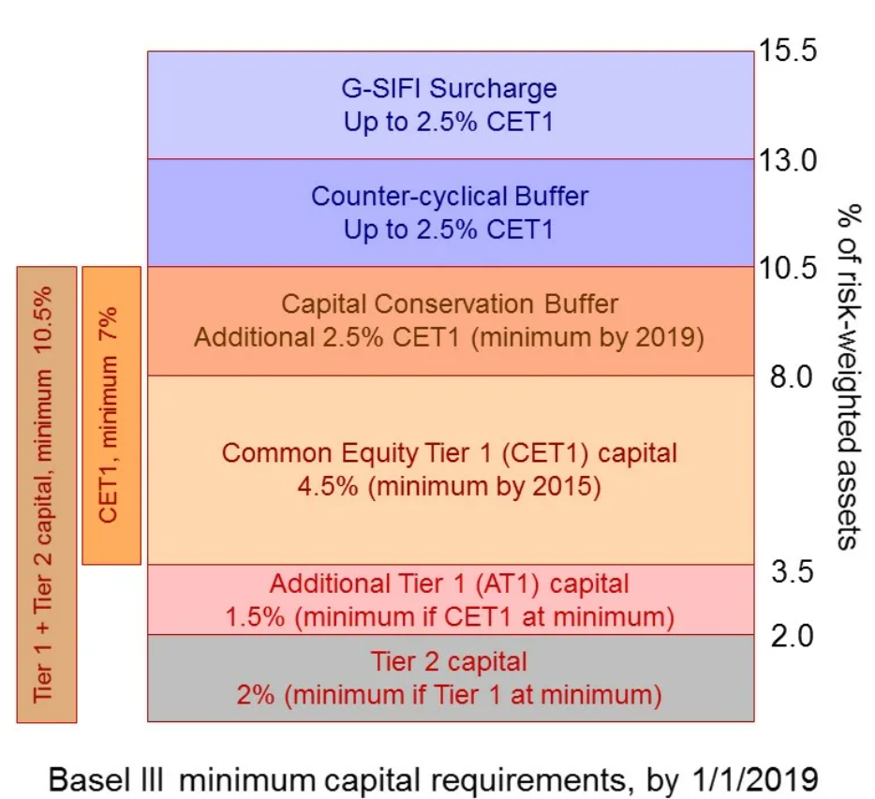
Capital adequacy ratio
IE2.2
Tier 1 (going concern) | Common Equity Tier 1 (CET1) | Sum of common shares (equivalent for non-joint stock companies* ) and stock surplus, retained earnings, other comprehensive income, qualifying minority interest and regulatory adjustments | (Н1.1) $\frac{CET 1}{RWA}$ > 4.5%
 | Additional Tier 1 (AT1) | Sum of capital instruments meeting the criteria for AT1 and related surplus, additional qualifying minority interest and regulatory adjustments | (Н1.2) $\frac{CET 1+AT1}{RWA}$ > 6%
Tier 2 (gone concern) |  | Sum of capital instruments meeting the criteria for Tier 2 and related surplus, additional qualifying minority interest, qualifying loan loss provisions and regulatory adjustments | (Н1.0) $\frac{CET 1+AT1+Tier 2}{RWA}$> 8%
Allowances used to regulate dividends:
Maintaining capital adequacy = 2.5%
Countercyclical buffer = 0%
Systematically important banks =1%
RWA = Credit risk + Market risk + Operational risk
¹https://www.bis.org/fsi/fsisummaries/defcap_b3.pdf
Criteria mentioned in the table above - https://www.bis.org/publ/bcbs189.pdf and 199-И for Russian specifics

Slide 20
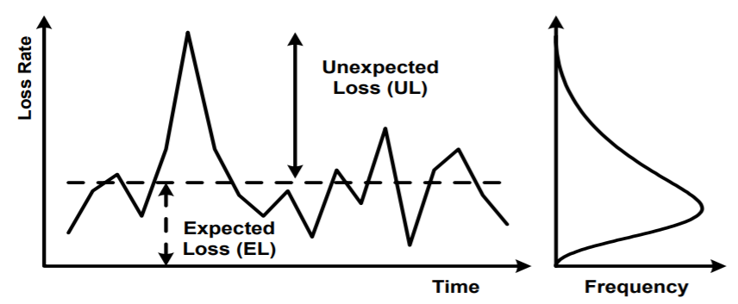
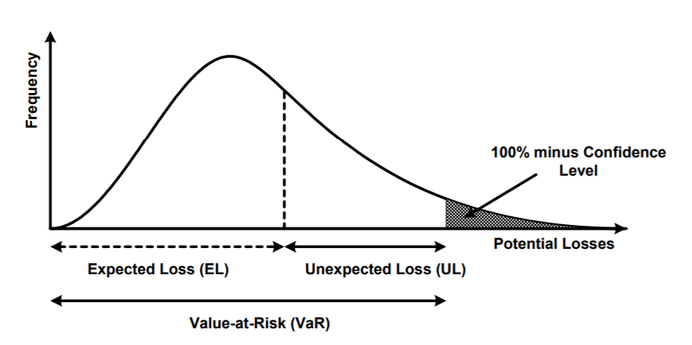
Market risk RWA – intro (1/2)
Capital adequacy ratio (CAR) $=\frac{Total capital}{Credit risk + Market risk + Operational risk}$ ⩾ 8%
Keep in mind 2 ideas:
the concept of all calculations below is the same as VAR
final goal of calculations is to measure the loss on a position during a crisis and reserve capital to cover it
RWA on market risk is calculated only on trading book. Banking book covered by credit risk methodology.

Slide 21
Market risk RWA – intro (2/2)
There are 3 calculation methodologies:
Simplified Standardized approach = Russian prudential methodology “511-П”
Standardized approach
Advanced approach
All 3 methodologies cover following types of market risk:
Interest rate risk (bonds, derivatives)
Equity risk (equities)
FX risk (FX exposures)
Commodities risk (commodity derivatives)

Slide 22
Simplified Standardized approach (1/4)
Interest rate risk:
Specific risk (designed to protect against an adverse movement in the price of individual security)
  +
General market risk (designed to capture the risk of loss arising from changes in market interest rates). Calculated as a choice between two principal methods a maturity method and a duration method. In each method, the capital requirement is the sum:
  the net short or long position in the whole trading book;
  a small proportion of the matched positions in each time band (the “vertical disallowance”);
  a larger proportion of the matched positions across different time bands (the “horizontal disallowance”); and
  a net charge for positions in options, where appropriate (see [MAR40.84] and [MAR40.85]).
  +
Interest rate derivatives

Slide 23
Simplified Standardized approach (2/4)
Equity risk:
Specific risk, defined as the bank’s gross equity positions (Credit risk)
  +
General market risk defined as the difference between the sum of the longs and the sum of the shorts (risk fluctuations of FV)
  +
Equity derivatives

Slide 24
Simplified Standardized approach (4/4)
Commodity risk:
Maturity ladder approach
  or
Simplified approach
+
Commodity derivatives

Slide 25
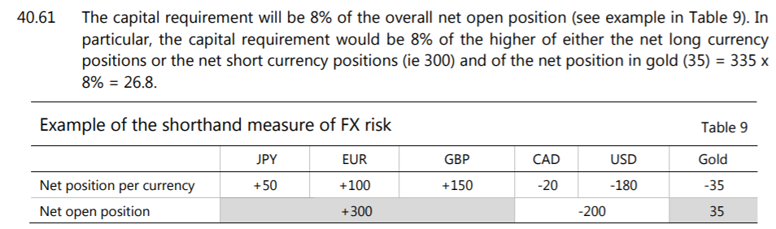
Simplified Standardized approach (3/4)
IE3.4
FX risk:
Measure the risks inherent in a bank’s mix of long and short positions in different currencies as set out in

