Slide 1
4.1 Liquidity risk
Definition of liquidity risk
Liquidity in stress

Slide 2
Liquidity risk – definition
Liquidity is the ability of a firm to pay its debts without suffering catastrophic losses or paying its debt at all.
Liquidity risk stems from:
the lack of marketability of an investment that can't be sold quickly enough to prevent or minimize a loss or can’t be sold at all.
the structure of the portfolio
We are speaking here only about banking book, liquidity of the trading book is handled by the trading department and follows rules discussed in chapter №3

Slide 3
Specifics of Liquidity risk
Credit risk
Market risk
Operational risk
Other types of risk
Risk of liquidity
Losses
Losses or Default
Liquidity risk may not be capitalized in stress! This risk cannot be handled by PL and the bank goes bankrupt.

Slide 4
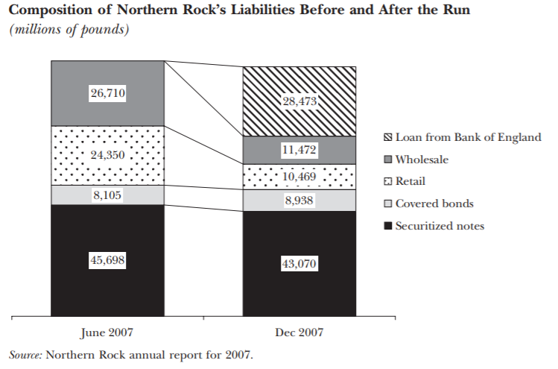
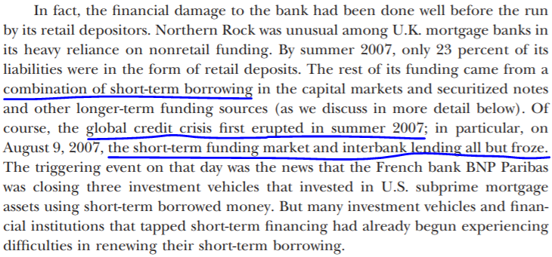
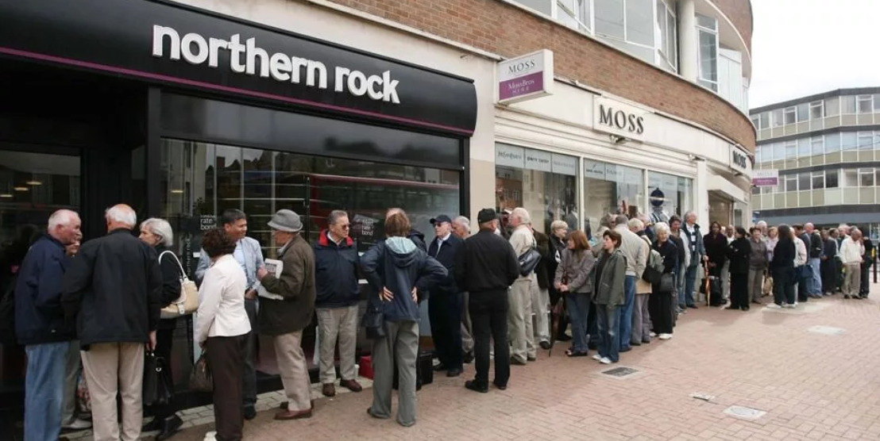
Northern Rock example*
*https://www.bis.org/publ/shin_2009.pdf

Slide 5
Factors of liquidity risk in stress
Assets:
Shortage of physical liquidity
Squeeze of possible liquidity reserves (devaluation of pledges or increase of discounts for repo deals and etc.)
Deterioration of liquidity of the assets (absence of active market)
Utilization of credit lines => growth of loan portfolio
Liabilities:
Banking run
Squeeze of the interbank loan market
Withdrawal of big deposits
During a crisis, all abovementioned factors are realized to some extent

Slide 6
4.2 Liquidity risk
Liquidity risk management tools and managing of liquidity of bank
Role of Asset and Liability COmmittee (ALCO)
Types of liquidity risk and its risk metrics
Limits on liquidity risk metrics
Business as usual and crisis management of liquidity

Slide 7
Liquidity risk management tools
Accept:
Funding
Disposing assets
Share: n/a
Control, Mitigate:
Risk appetite limits
ALCO limits
Regulatory limits

Slide 8
Specifics of rising liquidity through
funding:
investments:
Types of Funding | Features
Corporate deposits and CA | Short term and can be withdrawn at any time (de-facto floating rate instrument) Very sensitive to interest rate shifts Concentration
Retail deposits and CA | Longer term than corporate Less sensitive to interest rate shifts More exposed to panic
Government funding | Always bounded to key rate (floating rate) Requires high quality collateral Limited capacity
Interbank and derivatives | Short term Very sensitive to interest rate Shrinks during the crisis Limited capacity
Bonds | Long term and non sensitive to interest rate shifts Difficult to issue
Types investments | Features
Sell of securities | Limited capacity and it is shrinking during crisis High discounts
Sell of loans
Cutting off balance | Reputational risks

Slide 9
“Cannibalization” effect of changing interest rates on example of deposit
 | If we set this interest rate: | We will attract this amount of funding: | It will cost us interest expense on 1y horizon:
Option 1 | 6.5% | 1200 | 6.5%*1200=78.0
Option 2 | 7.5% | 1500 | 7.5%*1500=112.5
 | Additional funds if we raise interest rate on 1pp=> | 1500-1200=300
 | Factual cost of this additional funds => | (112.5 - 78) / 300 = 11.5% | because we attract whole sum at a higher price

Slide 10
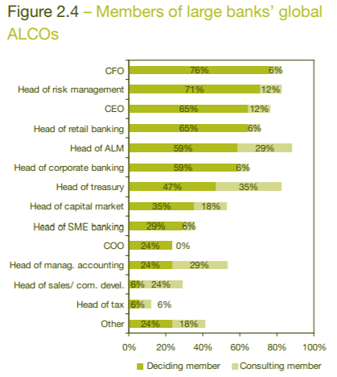
Asset and Liability COmmittee – ALCO (КУАП)
Duties and responsibilities of ALCO:
1. Risk diversification and capital requirements
2. Liquidity management policy at the financial institution
3. Broad and specified policy on capital markets requirements
4. Yield and size of bank’s trading policy, including diversification between the type of instruments and currency
5. Interest rate and liquidity policy
6. Capital adequacy and risk policy
7. Benchmarking performance indicators
Good practice for ALCO to be consisted of business and analytical/compliance representatives in 50/50 proportion
https://www.pwc.at/en/publikationen/financial-services/asset-liability-benchmark-study-2006.pdf

Slide 11
Liquidity risk types and relevant metrics
IE4.1
Physical liquidity – lack of cash and non-cash liquidity
Structural liquidity – concentration in currency, products, clients, maturities in balance structure
Regulatory liquidity – non-compliance with regulatory liquidity ratios (Russian regulatory practice Н2, Н3, Н4, Н26 и Н28, Basel: NSFR, LCR)
● Physical liquidity:
● Structural liquidity:
● Regulatory liquidity:
Available liquidity (in different currencies) [300 mln]
Liquidity position (in different currencies) [500 bln]
Survival horizon (one for all currencies) [>180 days]
Cumulative liquidity gap (in different currencies on different horizons) [20 mln]
LDR [ratio]
Share of government funding [ratio]
Concentration of top 1, 3, 5 borrowers in funding [ratio]
Н2, Н3, Н4 – Russian regulatory ratios (analogue of LCR and NSFR) [ratio]
LCR (H26) [ratio]
NSFR (Н28) [ratio]

Slide 12
Physical liquidity metrics (1/2)
Available liquidity = Reserve (Potential of fast attraction of loans secured by bonds (repo with CB or another banks) or other loans (4801 program in Russia) + Stock (Net O/N interbank)
Shows funds available in short term in case of emergency
Liquidity position = Investments with repayment ⩽ 6 month - Funds with repayment ⩽ 6 month
Shows funds which can be allocated to business developments in mid term
Survival horizon = Calculated by internal banking models, based on internal statistics and particular stress scenario (basically in business planning conservative scenario and ICAAP top-down stress scenario).
Shows how much time bank will survive effects from slide № 5 without applying any measures from slide №8
Start of the stress
Survival horizon (in days)

Slide 13
Physical liquidity metrics (2/2) and structural liquidity
Liquidity gap = difference between inflows and outflows
Cumulative liquidity gap = sum of liquidity gaps. The most popular metric to analyze is the 1-year cumulative liquidity gap and its structure
LDR= $\frac{Loans to clients + HTM∗ + Securitisation∗∗}{Deposits and CA+Bonds issued(exc. repurchased)}$
Evaluates if bank funded by stable source of liquidity or not
*HTM – held to maturity
**Securitization – FV of bonds acquired by securitization

Slide 14
Regulatory liquidity
Net stable funding ratio (NSFR) H28 in Russia
Availability of stable funding of the banking group to fund balance assets and credit-related commitments on > 1-year horizon
Liquidity coverage ratio (LCR) H26 in Russia
Ability of the banking group to fulfill its obligations during 30 days in the stress of liquidity using its liquidity cushion
Share capital | 100%
Corporate deposits and CA >1year | 100%
All retail deposits and CA | 90%
Corporate deposits and CA <1year | 50%
All other funding (incl bonds issued) | 0%
Cash | 100%
O/N loans to Central bank | 100%
Sovereign bonds | 100%
Corporate bonds (not less than BBB-) | 50%
LCR= $\frac{High quality liquid assets}{Cash outflows for 30d − Cash inflows for 30d}$>100%
NSFR= $\frac{Available stable funding (ASF)}{Required stable funding (RSF)}$>100%
Funding from central bank <30d | 0%
All retail deposits and CA | 10%
Corporate deposits and CA <30d | 40%
Interbank borrowings <30d | 100%
Other borrowings < 30d | 100%
Credit related commitments | 5-100%
Interbank loans granted <30d | 100%
All other loans granted <30d | 50%
O/N loans to Central bank | 0%
Sovereign bonds | 5%
Corporate bonds (not less than BBB-) | 15%
Interbank loans granted <6m | 15%
Other loans granted < 1 year | 50%
Other loans granted> 1 year | 85%
Other assets | 100%
Credit related commitments | 5%

Slide 15
Risk appetite limits and ALCO limits
2 types of possible limits on liquidity metrics: Risk appetite and ALCO
On example of LCR:
If breached:
Calculated based on:
Liquidity forecast in baseline scenario of business plan
120%
ALCO trigger
Limited adjustments (slide 8)
Yellow limit of risk appetite and ALCO limit
Liquidity forecast in conservative scenario of business plan
110%
Significant changes (slide 8)
Inform regulator and provide remediation plan
105%
Red limit of risk appetite
Liquidity forecast in stress scenario
Can be breached only in severe crisis, otherwise sanctions from regulator
100%
Regulatory limit
Predetermined by regulator

Slide 16
Regimes of liquidity risk management
2 different regimes o liquidity management:
Business as usual, main tools:
Forecast of balance, inflows/outflows and
Funding plan
Crisis management, main tools:
Stress testing
Liquidity contingent plan (LCP)
Early warning indicators (EWI)

Slide 17
Forecast of loan portfolio
Drivers | Instruments
New deals | Portfolio level models based on macroeconomic forecasts and internal data Pipeline of new loans constructed on expectation of business development Borrower level models assessing probability and volume of new business based on abovementioned pipeline
Early repayments | Early repayment models based on internal statistics of the bank
Contractual repayments | Contractual terms

Slide 18
Funding plan (till the end of 2022)
Directions | Qualitative prediction | Quantitative prediction
Rubbles | Structural surplus* of rub liquidity due to slowdown of originating new loans | From 0,5 trln rub, to 2 trln rub
FX currencies | EUR and USD liquidity will increase due to lack of import and decline in export. Continuous flee from USD and EUR into CNY should be considered | Free liquidity on the market: USD - from 20 to 40 bln EUR: from 15 to 30 bln CNY: from 70 to 200 bln
Regulation | Bank of Russia’s relaxation of regulation on H26 and H28 may be cancelled | Bank have to attract 15 bln rub of high quality liquid assets
Risks | Economic decline due to war and sanctions Capital outflow Stop using USD and EUR
* The banking sector structural liquidity deficit is the state of the banking sector which implies the existence of bank’s permanent need of raising funds with the CBR operations, in case of structural liquidity surplus - permanent need of allocating funds through the CBR operations. https://cbr.ru/eng/hd_base/bliquidity/

Slide 19
Business as usual liquidity management
Daily (Monitoring) | Calculation and monitoring of liquidity risk metrics (slide 11)
Weekly (Management) | Forecast of the balance and liquidity Making operations on money market (slide 8) Factor analysis of liquidity changes (slide 5) Reporting to executives (business, treasury, risks)
Monthly (Analysis) | Sensitivity analysis and stress testing (slide 14) Back testing of the processes and estimations
Quarterly / Annually (Strategy) | Business planning Strategy Funding plan (slide 19)

Slide 20
4.3 Crisis
Definition of crisis and main crisis management elements
Interesting papers on crisis management from the Central bank perspective: https://www.bis.org/fsi/publ/insights38.pdf https://www.imf.org/external/pubs/ft/wp/2010/wp1070.pdf
Interesting paper on crisis management on example of managing COVID pandemic: https://ec.europa.eu/info/sites/default/files/ht0921295enn.en_.pdf

Slide 21
Crisis management
I. What is the crisis?
Sharp deterioration of liquidity or capital risk metrics
Sharp deterioration of macroeconomics metrics or banking sector metrics
Decision of Management
II. Key elements of crisis management:
III. Other considerations:
Start react as early as possible,
If the situation is to much uncertain "do not act at all and wait until more details available" could be a possible solution. Mistakes and overreaction may cause more damage then crisis itself.
№ | Elements | Considerations
1 | Criteria of crisis | Define quantitative and qualitative criteria of the crisis
2 | Early warning signals | Based on above mentioned criteria, do your best to anticipate upcoming crisis, its type and severity as early as possible
3 | Relevant reaction plan | Prepare in advance clearly defined action plan for the most probable crisis scenarios. Such plan should: be prudent; contain exact measures and its implication on RAF metrics and PL of the bank, for each measure responsible bodies should be assigned
4 | Sole centre of decision making | Have in place a body which is: representative; possess necessary power and awareness; can be gathered within a day and start making decisions. Commonly it is ALCO or Board of directors
5 | Urgent reaction | Critical phase of ordinary crisis is from 2 week up to 1 month. Organisation should be prepared to maximum possible load at this period
6 | Crisis reporting | Reporting of new metrics may be demanded or frequency of reporting current metrics may increase. IT systems and personnel of the Bank should have margin of safety to cope with it

