Slide 1
5.1 Introduction
Interest rates level - general introduction (interest accruals, key rate, treasury yields)

Slide 2
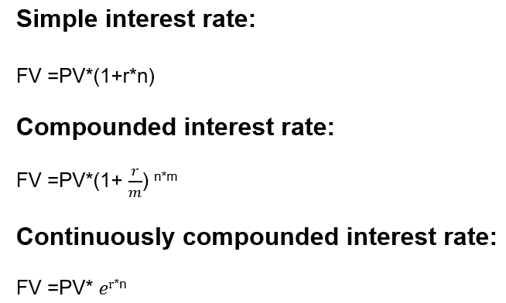
Interest accruals
IE5.1
FV:

Slide 3
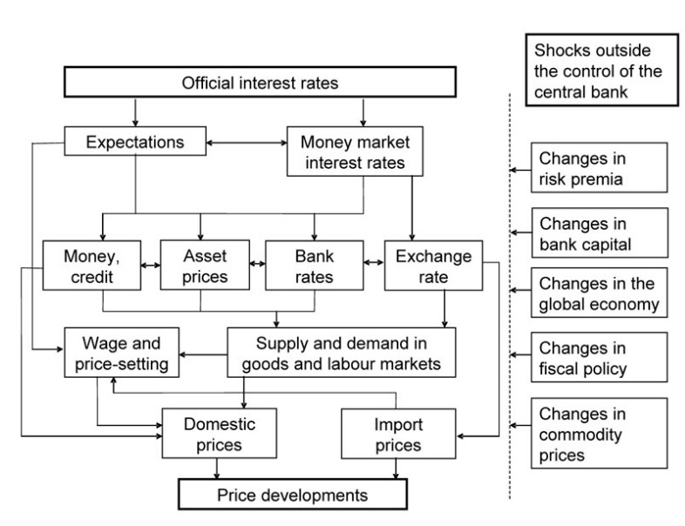
Key rate¹:
plays information and signal role in monetary policy
is the minimum interest rate on 1 week reverse REPO auction with CB or the maximal interest rate on deposits in CB (In order to make reverse REPO with CB bank needs to possess securities from Lombard list²)
main goal => in Russia targeting inflation. In some other countries targeting inflation and unemployment
For your record, except reverse repo banks can attract funding from CB pledging high credit quality loans (4801-Y scheme ⁴)
Transmission mechanism³ :
¹ https://cbr.ru/eng/hd_base/KeyRate/
² https://cbr.ru/eng/analytics/lombardlist/
³ https://www.ecb.europa.eu/mopo/intro/transmission/html/index.en.html
⁴ https://cbr.ru/oper_br/t_odm/secured_loans/

Slide 4
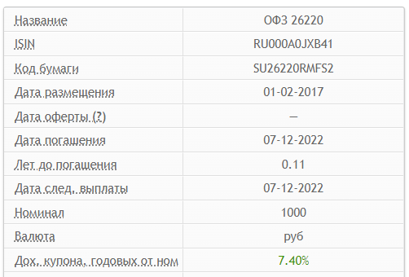
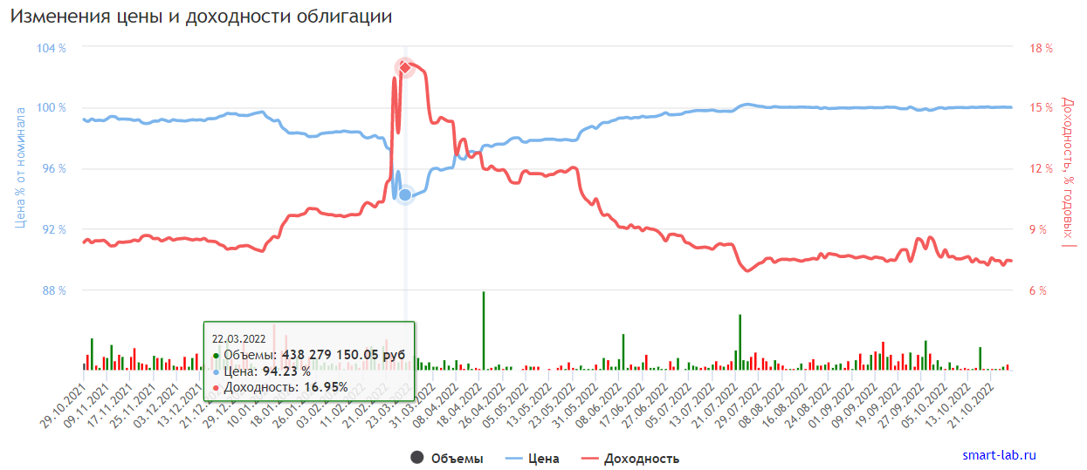
Interest rate curve
IE5.2
Shapes of treasury yield curve ¹ :
Normal curve - reflects investor expectations for the economy to grow in the future and, importantly, for this growth to be associated with a greater expectation that inflation will rise in the future rather than fall. This expectation of higher inflation leads to expectations that the central bank will tighten monetary policy by raising short-term interest rates in the future to slow economic growth and dampen inflationary pressure.
Flat curve - sends signals of uncertainty in the economy.
Inverted curve – reflects investor expectations for the economy to enter a recession shortly
Evolution of treasury yield on OFZ example ²
¹ https://cbr.ru/hd_base/zcyc_params/
² https://smart-lab.ru/q/ofz/

Slide 5
Treasury yield = risk free rate
IE5.2
Treasury Yield = Risk-free rate = [C + ((N - PP) / T)] ÷ [(N + PP)/2]
where C= coupon rate
N = face value or nominal
T = years to maturity
PP = purchase price
The yield on a 10-year note with a 3% coupon purchased at a premium for $10,300 and held to maturity is:
Treasury Yield = [$300 + (($10,000 - $10,300) / 10)] ÷ [($10,000 + $10,300) / 2] = $270 / $10,150 = .0266 rounded, or 2.66%
Why is Treasury Yield = Risk-free rate?
The logic is the following:
Investors anticipate the change of key rate, because of the inflation spike or currency control measures (geopolitical crisis in 2014) or interventions to prevent bunking run (geopolitical crisis in 2022) or etc.
For instance: Increase of key rate leads to increase of coupons on new treasuries => PV of old instruments decrease (discounting rate increase) => Purchase Price decrease. And vice versa.
Hence Treasury yield is market anticipation of key rate level
Fixed at origination
Defined on the market

Slide 6
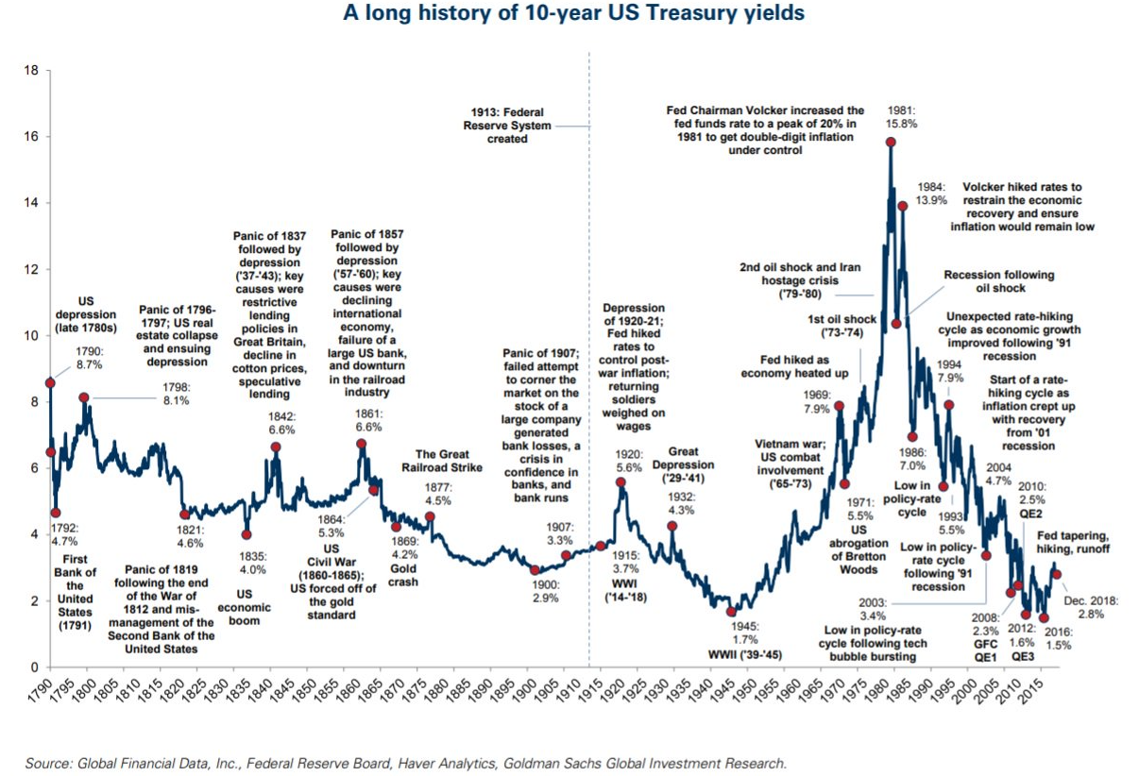

Slide 7
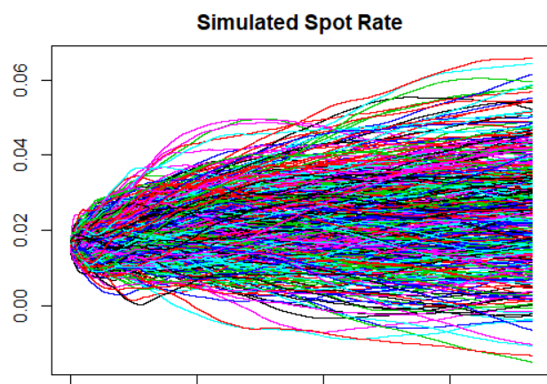
Risk-free rate prediction¹
Hull-White model
Input:
Current interest rate curve
History of changes (volatility) on the level of tenors
Output:
Distribution of possible interest rate curve
Manual adjustment based on the professional judgment of macroeconomists (technically via playing with HW calibration coefficients)
1. Hull-White 1-factor model using R code | R-bloggers

Slide 8
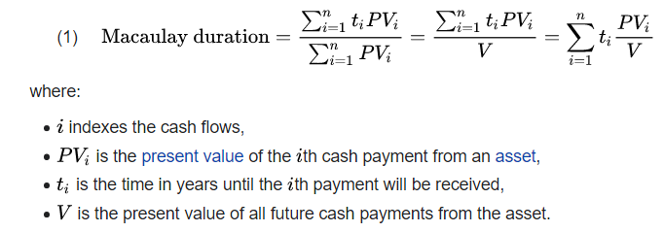
Macaulay duration and Modified duration
IE5.2
It should be remembered that although Macaulay and modified duration are closely related, they are conceptually distinct.
Macaulay duration is a weighted average time until repayment (measured in units of time such as years)
while modified duration is a price sensitivity measure when the price is treated as a function of yield, the percentage change in price with respect to yield

Slide 9
5.2 Interest rate risk (IRR)
Foundations
Interest rate risk metrics
Instruments of managing

Slide 10
Main function of the bank is the transformation of risks
Main types of transformation*: | Meaning | Types of risks involved
Transformation of scales | A bank can combine 1000 savings accounts with a balance of 100 and use as funding for a mortgage loan of 100,000 dollars | Liquidity risk
Transformation of availability | If you go to a bank and want to deposit some money there, you expect them to always accept it. Likewise, if you go to an ATM (Automatic Teller Machine) to get some cash, you expect to receive it | Liquidity risk
Transformation of credit risk | Some borrowers may fail to return the loans, at the same time bank obliged to return all customer accounts | Credit risk
Transformation of duration | Loans tend to be long-term (up to 20-30 years for mortgages), whilst customer accounts are much shorter | Interest rate risk
Banks have to include each type of transformation in the product’s price.
* Non irrefragable list of types of transformations
https://rudhar.com/economi/monydebt/en/005bnkfn.htm

Slide 11
Business model of banks in 1950-1960
Rule 3 – 6 – 3:
3% = > interest rates on deposits
6% = > interest rates on loans
At 3 p.m. = > golf
During the 1979-1980 crisis in the USA interest rates soared, and liabilities repriced much faster than assets:
Interest rates raised on 15 p.p.
Losses of banking system ~ 1 trln $

Slide 12
Transformation of duration
The average term of liability is 1 year, and it may drastically decrease due to crisis (clients withdraw current accounts or deposits ahead of schedule)
The average term of the asset is 5 years (from 3 to 30 years)
If the interest rate curve is normal, the bank will have a positive interest margin this year => 100*6.2%-100*5.3% = 0.9
But
If the interest rate curve is inverse, the bank will have a negative interest margin this year => 100*6.2%-100*6.8% = -0.6

Slide 13
Interest rate risk (IRR) definition and types¹
IE5.4
Definition:
Interest rate risk is the risk that arises for asset and liability structures from fluctuating interest rates.
Types of interest rate risk
Gap risk arises from the term structure of banking book instruments and describes the risk arising from the timing of instruments’ rate changes
changes to the term structure of interest rates occur consistently across the yield curve (parallel risk)
or
differentially by period (non-parallel risk)
Basis risk describes the impact of relative changes in interest rates for financial instruments that have similar tenors but are priced using different interest rate indices. For instance, you funded a 1-year loan (key rate + 3%) with 1-year deposit (mosprime 3m - 1%). Basis risk realizes in this case if the key rate decrease and mosprime 3m do not.
Option risk arises from option derivative positions or from optional elements embedded in a bank’s assets, liabilities, and/or off-balance sheet items, where the bank or its customer can alter the level and timing of their cash flows.
External factor
Internal factors
¹ https://www.bis.org/bcbs/publ/d368.pdf

Slide 14
Risk metrics of IRR
Name of the instrument | Nature of calc
1. Interest rate gap | Shows the distribution of assets and liabilities across tenors on which the interest rate may change according to contractual terms
2. The direct and indirect method of interest rate sensitivity analysis (∆NII) | Estimation of effect on PL for given horizon after specified change of interest rate curve
3. ∆EVE (Economic Value of Equity) | Estimation of change of the value of the bank itself
4. Economical capital | Estimation of loss (NII and/or EVE) from the realization of the shock of interest rates which should not be exceeded with some predetermined probability

Slide 15
1. Interest rate gap
IE5.3
The interest rate gap - a disparity of repricing assets and liabilities after a shift in interest rates (list “IR gap…”, step 2).
How can such “repricing” realize?:
Repayment of principal on assets/liabilities
Floating rates
The main extensions of interest rate gap calculations are (optionalities):
Deposit withdrawal model
Loan prepayment model / refinance
Overdue (less important and more difficult to predict)

Slide 16
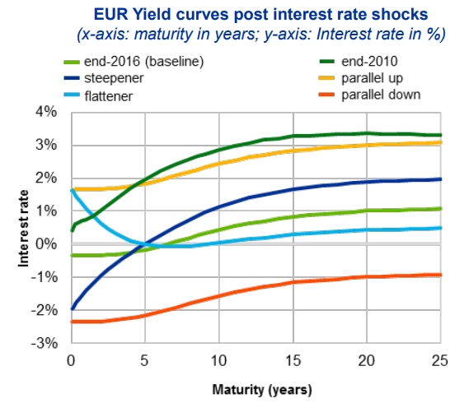
2. Interest rate sensitivity calculation by the indirect method (∆NII)
IE5.3
3 step: calculate the effect on PL (list “Interest rate sensitivity”, step 3.1 in excel) for all 6 types of interest rate curve shifts:
parallel shock up;
parallel shock down;
steepener shock (short rates down and long rates up)²;
flattener shock (short rates up and long rates down) ²;
short rates shock up ²;
short rates shock down ²
!!!Even if for regulatory purposes, banks perform analysis on a 12m horizon, for internal purposes, banks expand the horizon for analysis up to 3-5 years
¹ 1step in excel has a parallel shift in interest rates
² For non-parallel shift banks calculate double dimensional interest rate gap (details on slide N 20)

Slide 17
∆ NII calc on one-dimensional interest rate gap vs two-dimensional interest rate gap
One-dimensional gap:
Can be used only for a parallel shift
Two-dimensional gap:
Used for non-parallel shift
$$\text{∆}NII=1\%∗\sum_{k=1}^{n}{CFk∗tk}$$
$$\text{∆}NII=\sum_{i=1}^{m}{ }\sum_{k=1}^{n}{CFik∗tk∗\text{∆}Ri}$$
$$∗tk∗\text{∆}Ri$$
$\text{∆}NII$ =
One-dimensional gap

Slide 18
3. ∆EVE (Economic Value of Equity)
IE5.3
∆ EVE In a short:
EVE = NPV¹ of inflows on interest-bearing assets – NPV¹ of outflows on interest-bearing liabilities
∆ EVE = EVE in stress scenarios ² – current EVE
∆ EVE In a long:
Banks should exclude their own equity from the computation of the exposure level.
Banks should include all cash flows from all interest rate-sensitive assets, 11 liabilities and off-balance sheet items in the banking book in the computation of their exposure. Banks should disclose whether they have excluded or included commercial margins and other spread components in their cash flows.
Cash flows should be discounted using either a risk-free rate 12 or a risk-free rate including commercial margins and other spread components (only if the bank has included commercial margins and other spread components in its cash flows). Banks should disclose whether they have discounted their cash flows using a risk-free rate or a risk-free rate including commercial margins and other spread components.
∆EVE should be computed with the assumption of a run-off balance sheet, where existing banking book positions amortise and are not replaced by any new business.
¹ discounting by risk-free interest rates
² discounting by risk-free interest rates for all 6 scenarios

Slide 19
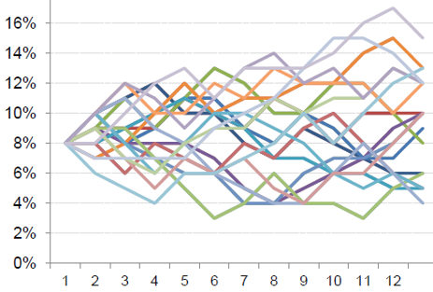
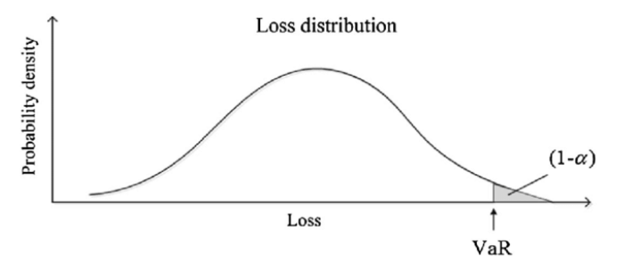
4. Economic capital
IE5.3
Step 1. Prediction of different forms of interest rate curves based on different macroeconomic scenarios (better to use the same scenarios as for credit risk EC calc)
Step 2. Based on step 1, we use the indirect method to calculate the losses for each scenario, then form the distribution of these losses and finally pick up the value based on the confidence level we prefer
Such calc for ∆ NII could reflect ECAP on the short-term horizon. At the same time, ∆ EVE could reflect ECAP on the economic cycle horizon.
This approach is the most advanced and requires sophisticated modelling techniques.
It is recommended to use for Economic capital calculations on interest rate risk for ICAAP purposes and limits for RAF on IRRBB.

Slide 20
Pros and cons of IRR risk metrics
Name of the instrument | Pros | Cons
1. Interest rate gap | Clear, concise and easy to calculate | Do not provide quantitative assessment
2. The direct and indirect method of interest rate sensitivity analysis (∆NII) | Clear, concise and easy to calculate | Limited on 1 year horizon
3. EVE | Useful from beneficiary perspective | Not straightforward
4. Economical capital | Show maximal possible loss | Difficult to model

Slide 21
Regulatory requirements for IRRBB (NII and EVE)
[Have the forecasts for 6 scenarios and proper calculations in place] Greater guidance has been provided on the expectations for a bank’s IRRBB management process, in particular the development of shock and stress scenarios (Principle 4) to be applied to the measurement of IRRBB, the key behavioural and modelling assumptions which banks should consider in their measurement of IRRBB (Principle 5) and the internal validation process which banks should apply for their internal measurement systems (IMS) and models used for IRRBB (Principle 6).
[Disclose the IRRBB metrics in Pillar 3 report] The disclosure requirements under Principle 8 have been updated to promote greater consistency, transparency and comparability in the measurement and management of IRRBB. Banks must disclose, among other requirements, the impact of interest rate shocks on their change in economic value of equity (∆EVE) and net interest income (∆NII), computed based on a set of prescribed interest rate shock scenarios.
[Regulators can and should challenge the approaches of management of IRRBB] The supervisory review process under Principle 11 has been updated to elaborate on the factors which supervisors should consider when assessing the banks’ level and management of IRRBB exposures. Supervisors could also mandate the banks under their respective jurisdictions to follow the standardised framework for IRRBB (eg if they find that the bank’s IMS does not adequately capture IRRBB). The standardised framework has been updated to enhance risk capture.
[High attention to the banks with the outliers in NII and EVE + “capital consequences”] Supervisors must publish their criteria for identifying outlier banks under Principle 12. The threshold for the identification of an “outlier bank” has also been tightened, where the outlier/materiality test(s) applied by supervisors should at least include one which compares the bank’s ∆EVE with 15% of its Tier 1 capital, under a set of prescribed interest rate shock scenarios. Supervisors may implement additional outlier/materiality tests with their own specific measures. There is a strong presumption for supervisory and/or regulatory capital consequences, when a review of a bank’s IRRBB exposure reveals inadequate management or excessive risk relative to a bank’s capital, earnings or general risk profile.
ECAP calculations for IRRBB under ICAAP
Interest rate risk in the banking book (bis.org)

Slide 22
Link on research=>
ssm.pr171009_slides.hu.pdf

Slide 23
Link on research=>
ssm.pr171009_slides.hu.pdf

Slide 24
Link on research=>
ssm.pr171009_slides.hu.pdf

Slide 25
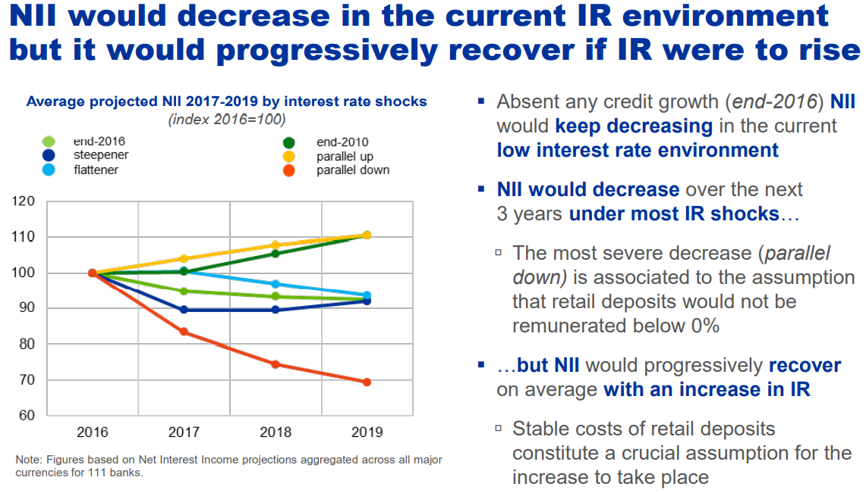
Link on research=>
ssm.pr171009_slides.hu.pdf

Slide 26
Link on research=>
ssm.pr171009_slides.hu.pdf

Slide 27
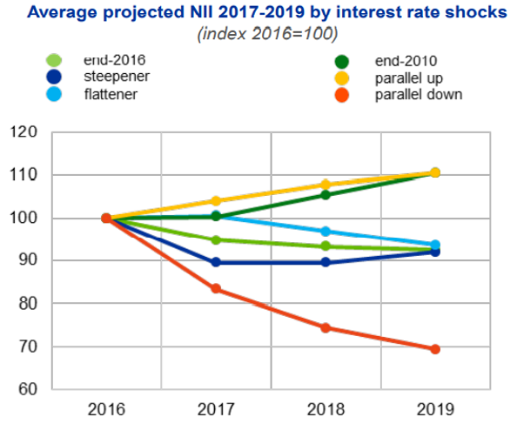
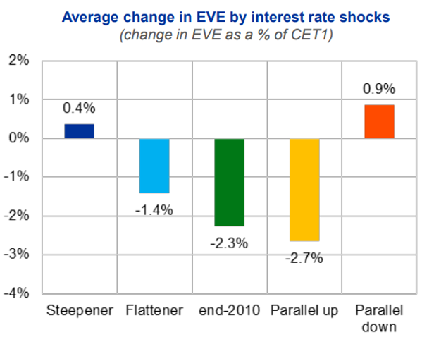
Results – once more
Link on research=>
ssm.pr171009_slides.hu.pdf

Slide 28
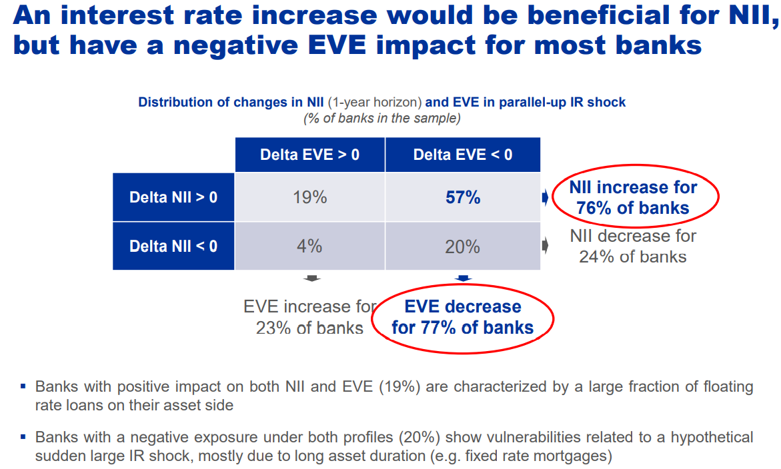
Link on research=>
ssm.pr171009_slides.hu.pdf

Slide 29
Link on research=>
ssm.pr171009_slides.hu.pdf

Slide 30
Link on research=>
ssm.pr171009_slides.hu.pdf

Slide 31
Link on research=>
ssm.pr171009_slides.hu.pdf

Slide 32
Levels of IRR managements
Strategy
Business plan
Operational level
Define target margin: ROE
Choose IRR management strategy: minimize risk, optimize risk-return or maximize profitability (slide 32)
Define the volumes of new business on the level of products/currencies
Define risk appetite limits for the business plan horizon (slide 13 incl. but not only)
Monitoring of metrics (slide 13 incl. but not only)
Making deals: loans, deposits, derivatives, etc

Slide 33
Strategies of IRR management
 | minimize risk | optimize risk-return | maximize profitability
Description | ~ prudent IRR risk limits; active use of interest rate derivatives avoid optionalities in contracts and etc | Somewhere in between | Maximization of interest income based on assumptions: level of int rates; form of curve; realization of optionalities, derivatives and etc.
1y NII | 6 mln | 12 mln | 18 mln
ECap | 25 mln | 60 mln | 120 mln

Slide 34
Instruments of IRR management
# | Instruments | Description
1 | Structuring the products | Floating rate Principal schedule Removing or adding optionality (slide 35)
2 | Limits | Defining the limit system with a variety of business and risk metrics on the level of business segments and products (slide 13)
3 | Hedging | Making hedging deals, mainly interest rate swaps (slide 34)
4 | Fund transfer pricing | Integration of market interest rate curve into structuring the deals both assets and liabilities (in details from 36 slide)

Slide 35
1. Steering of product structure - Optionalities
IE5.5
Any optionality in banking products should be recognized and influence the price of the products.
Examples of optionalities:
Right to repay the loan ahead of schedule,
The committed but not utilized credit line with a fixed rate,
Right to withdraw the deposit,
Right to replenish the deposit,
Floating rate with cap or floor,
Opportunity to convert in another FX or repay in another FX on fixed rate
For the details of calc, please see an illustrative example 5.5

Slide 36
3. Hedging
IE5.5
Original position
Sensitivity to 1p.p. up = -31.6
Hedged position
Sensitivity to 1p.p. up = 1.8
Hedging instrument:
Interest rate swap;
Contractual term 5 years;
Notional amount - 4 000
Receive rate - Mosprime 3m;
Pay rate - fixed rate

Slide 37
5.3 Fund transfer pricing
FTP curve
NII decomposition

Slide 38
Research questions
Who will receive a bonus?
Did we price our products adequately?
I./II. And now?
Loan 1Y
9% int rate
Deposit 1m
11% int rate
Interest margin +6%
Interest margin -2%
Deposit 1m
3% int rate
Loan 1Y
9% int rate

Slide 39
Decomposition of the interest margin (1/2)
Total interest margin = 6%
The margin for ALM risk* = 1,7%
The margin for liability = 2,2%
* ALM risks (IRR, FX risk, liquidity risk)

Slide 40
Decomposition of the interest margin (2/2)
A | Loan 1y 100$ | Contractual rate = 9% | The margin of the Asset originator 2,1%
VL | Virtual liability 1y 100$ | FTP rate = 6,9%
A | Loan 1y 100$*
L | Deposit 1m 50$*
VA | Virtual asset 1m 50$ | FTP rate = 5,2% | The margin of the Lability originator 2,2%
L | Deposit 1m 50$ | Contractual rate = 3%
VA | Virtual asset 1m 50$ | PL of The internal bank => 6% - 2,1% - 2,2% + instruments of management of liquidity and interest rate risks => ideally ~0
VL | Virtual liability 1y 100$
This representation is helpful for IRR management and PL on Internal bank. For liquidity risk internal bank works with real assets an liabilities
The internal bank should not be a revenue generating unit!
* for NII allocation FTP curve is fixed on the date of origination of the instrument

Slide 41
Proper management of liquidity risk and interest rate risk
Business Department
Treasury Department
liquidity or interest rate shock

Slide 42
General rule of FTP
The correct FTP is reached if asset and liability originators are equally unsatisfied

Slide 43
FTP construction – easy approach (1/2)
FTP = average cost of currently available funding on market
Not originated loans, originated deposits
Originated loans, not originated deposits
Drawbacks?
Market interest rate curve (= equilibrium price) is neglected = reality is neglected, as a consequence:
Business does not originate profitable* assets (red area) and originates not profitable* assets (black area)
Business does not originate profitable* liabilities (black area) and originates not profitable* liabilities (red area)
Business is stimulated to originate short deposits and long assets
* In terms of alternative costs

Slide 44
FTP construction – easy approach (2/2)
FTP = Weighted average (interest-bearing assets; interest-bearing liabilities) based on tenors and currencies
Drawbacks?
Liability originators will be demotivated to continue operations if the level of interest rates significantly increase, loan originators will receive unfair bust in PL

Slide 45
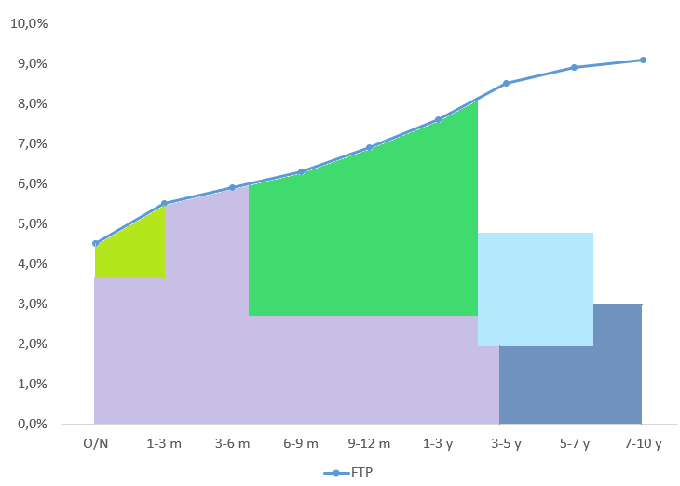
Principle 1 - FTP should reflect the factual cost of funds attracted by bank
Assumptions:
- The supply of the instruments should be enough to fund its operations
- Different for different currencies
- Cost of Optionalities included
- Other costs included (reserve requirements and deposit insurance payment)
Deposits of retail Clients
Interbank
Subordinated loans
Deposits of corporate Clients
Debt securities issued

Slide 46
Principle 2 - FTP curve should be continuous
If factual cost of fund are not covering some tenors, FTP for this tenors can be derived from market instruments + risk spread
If we need to form FTP for non liquid foreign currency we can use risk free rate of this currency adjusted on:
Relative risk spread of our bank (based on FTP curve vs risk free rate in other currency)
Shape of curve on other currency
Expert adjustments taking into account macroeconomics
Risk spread

Slide 47
Principle 3 – FTP should take into account current liquidity position of the bank
How should Bank amend FTP in order to cope with liquidity gap?

Slide 48
FTP components
Basic component
The current level of interest rate: risk-free rate ¹ + risk spread (for the average bank) or money market indices (Libor/Mibor) or IRS
Interest risk component
Behavioral spread
Modeling of shifts of the level in interest rates: Vasicek, Hull-White, etc.
FTP
Current funding structure and cost
Factual cost of funding (incl risk premium of current bank) + adjustment on the current liquidity position of the bank (slides 44, 47)
Funding and liquidity risk component
Regulatory costs
Cost of sustaining mandatory liquidity ratios (NSFR, LCR), reserve requirements, deposit insurance
Liquidity stress buffer
Cost of sustaining liquidity stress buffer, calculated according to internal models of the bank
Other
Manual expert adjustments
¹ https://cbr.ru/hd_base/zcyc_params/

Slide 49
Loan pricing
Costs
Interest rate
FTP
Cost of capital
Cost of risk
FV of embedded derivatives
OPEX
Target return
Inner cost of funding based on term, currency and schedule
Bank funds its activities not purely from borrowed funds, but using its capital as well.
Return on capital is usually higher than funding from market. Usually banks use regulatory or ECAP framework to calculate volume of capital allocated and use KPI on ROE as cost of capital
Credit Loss forecast for loan
Optionalities related to loan
Salary, tangible and intangible assets maintenance, and amortization, etc

Slide 50
Why schedule is important?
Term of both loans = 10 years
Principal of both loans = 13 000
Should we have the same FTP for pricing both loans?
w.a. funding cost for loan 1 = 6,7%
w.a. funding cost for loan 2 = 7,3%

Slide 51
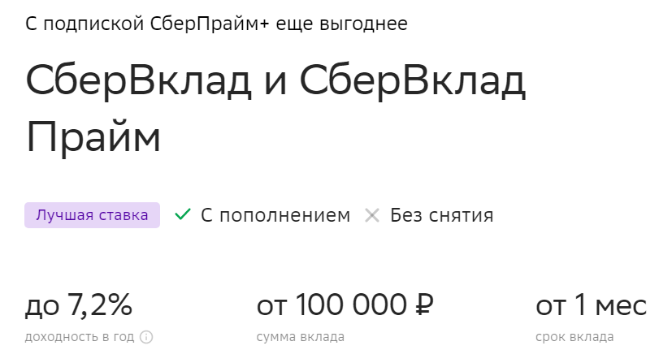
Deposit pricing
Costs
Interest rate
FTP’
Deposit Insurance
Reserve requirements
FV of embedded derivatives
OPEX
Target return
*Inner cost of funding based on term, currency and schedule
Payments to deposit insurance agency
The necessity to hold a share of deposits as a reserve in CB (to fund 100 rub investment we need to originate and pay for 100/(1-0,04) rub deposit
Optionalities related to deposits
As per 02/02/2023
Key rate = 7,5%

