Slide 1
FX risk - definition
FX (Forex) risk - potential financial losses that an investor may face due to fluctuations in currency exchange rates.
What if the FX rate changes from 1$=70rub to 1$=72rub:
Financial result: OCP in $ (open currency position) = 100-80 = +20$; PL=+20$*(72-70) = 40rub gain;
RWA credit risk: if RW=100%, RWA increase from 14 000rub to 7000+100*72=14 200rub;
RWA market risk: +20$*8%=1,6$. Increase from 1,6$*70 = 113,5rub to 1,6$*72 = 115,2rub
Liquidity: in this case, we have a positive effect on physical and regulatory liquidity metrics
Deposit insurance: increase in FX rate leads to an increase of quarterly insurance payments from 5600*0,12%= 6,72rub to 5760*0,12%= 6,91rub
What if the FX rate changes from 1$=70rub to 1$=45rub?
Stress test: PL=+20$*(45-70)= -500 rub loss. Can be calculated based on VAR.
What if the FX rate changes from 1$=70rub to 1$=145rub?
7. Correlation with credit risk: Borrowers may not be able to repay their debts. The bank will be forced to either convert loans in rub by favorable rate or charge provisions because of deterioration of credit quality. Note that the bank still needs to repay its liabilities according to contractual terms.
Assets*
Liabilities*
Loan 100$ (7000 rub)
Deposit 80$ (5600 rub)
Deposit 6400 rub
Loan 7000 rub
Capital 2000 rub
*FX rate 1$=70rub

Slide 2
1. OCP – Open currency position
IE6.1
Components included in calculation of OCP (pls find the calculation in illustrative example):
- Assets (Loans, Nostro) minus provisions
- Deposits, CA and other liabilities
- Spot and forward deals
- Guarantees provided in FX with conversion factor
The common approach of OCP management:
1. OCP of banking book ~0
The idea is that banking book represents a core banking activity and should generate stable income, not speculating income.
2. OCP of trading book depend on trading strategy
3. Total OCP of the bank could be limited by the local regulations. Local central bank may have the specific rules in place which penalize banks for having OCP.
Reporting the OCP to the top management:

Slide 3
3. RWA on market risk
FX risk:
Measure the risks inherent in a bank’s mix of long and short positions in different currencies as set out in

Slide 4
4. Regulatory liquidity
Net stable funding ratio (NSFR) H28 in Russia
Availability of stable funding of the banking group to fund balance assets and credit-related commitments on > 1-year horizon
Liquidity coverage ratio (LCR) H26 in Russia
Ability of the banking group to fulfill its obligations during 30 days in the stress of liquidity using its liquidity cushion
Share capital | 100%
Corporate deposits and CA >1year | 100%
All retail deposits and CA | 90%
Corporate deposits and CA <1year | 50%
All other funding (incl bonds issued) | 0%
Cash | 100%
O/N loans to Central bank | 100%
Sovereign bonds | 100%
Corporate bonds (not less than BBB-) | 50%
LCR= $\frac{High quality liquid assets}{Cash outflows for 30d − Cash inflows for 30d}$>100%
NSFR= $\frac{Available stable funding (ASF)}{Required stable funding (RSF)}$>100%
Funding from central bank <30d | 0%
All retail deposits and CA | 10%
Corporate deposits and CA <30d | 40%
Interbank borrowings <30d | 100%
Other borrowings < 30d | 100%
Credit related commitments | 5-100%
Interbank loans granted <30d | 100%
All other loans granted <30d | 50%
O/N loans to Central bank | 0%
Sovereign bonds | 5%
Corporate bonds (not less than BBB-) | 15%
Interbank loans granted <6m | 15%
Other loans granted < 1 year | 50%
Other loans granted> 1 year | 85%
Other assets | 100%
Credit related commitments | 5%

Slide 5
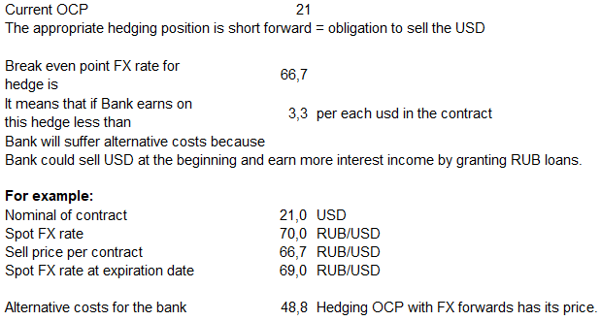
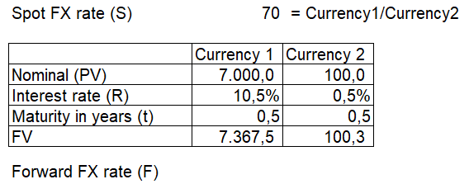
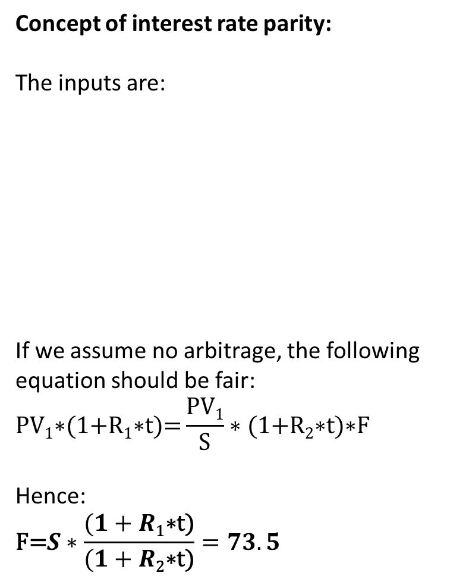
Interest rate parity and cost of OCP hedging
IE6.1
Concept of interest rate parity:
The inputs are:
If we assume no arbitrage, the following equation should be fair:
$$\text{PV}\text{1}\text{∗(1+}\text{R}\text{1}\text{∗}\text{t}\text{)=}\frac{PV1}{S}∗\text{(1+}\text{R}\text{2}\text{∗}\text{t}\text{)}\text{∗}\text{F}$$
Hence:
$$\text{F}\text{=}S∗\frac{(1+R\text{1}\text{∗}\text{t}\text{)}}{(1+R\text{2}\text{∗}\text{t}\text{)}}=73.5$$
Active OCP Hedging has implicit cost:

