Slide 1
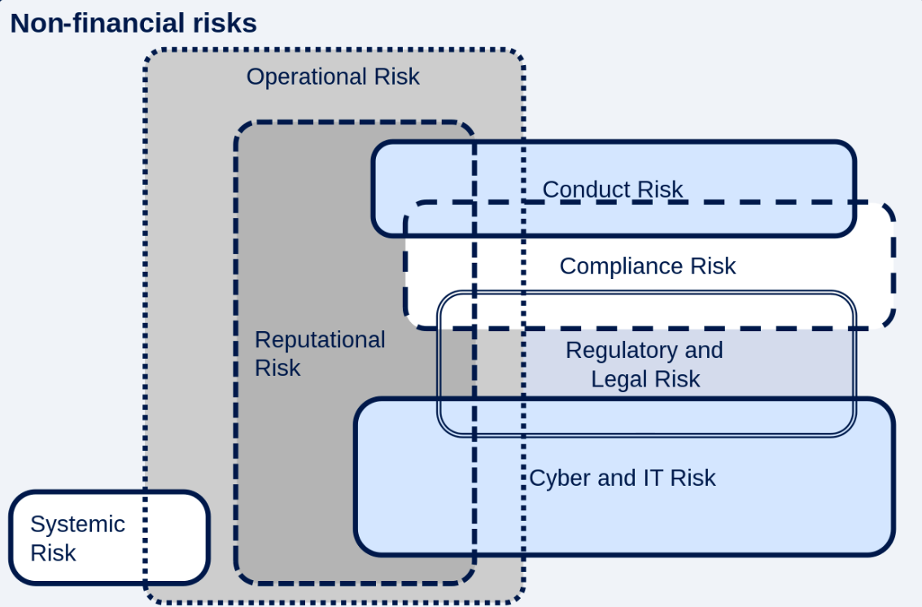
Taxonomy of operational risk
Basel committee definition of operational risk - the risk of loss from failed or inadequate processes, people systems or external events.

Slide 2
Operational risk - examples
Event-type | Categories | Example (full list in OPE25*)
Internal Fraud | Unauthorized activity | Transactions not reported (intentional) Transaction type unauthorized (with monetary loss)
 | Theft and fraud | Fraud / credit fraud / worthless deposits Theft / extortion / embezzlement / robbery
External Fraud | Theft and fraud | Theft / robbery Forgery
 | Systems security | Hacking damage Theft of information (with monetary loss)
Employment practices and workplace safety | Employee relations | Compensation, benefit, termination issues Organised labour activity
 | Safe environment | Employee health and safety rules events Workers compensation
 | Diversity and discrimination | All discrimination types
Clients, products and business practices | Suitability, disclosure and fiduciary | Breach of privacy Aggressive sales
 | Improper business or market practices | Market manipulation Insider trading (on firm's account)
 | Product flaws | Product defects (unauthorised etc)
Damage to physical assets | Disasters and other events | Natural disaster losses Human losses from external sources (terrorism, vandalism)
Business disruption and system failures | Systems | Hardware Software
*OPE25.pdf

Slide 3
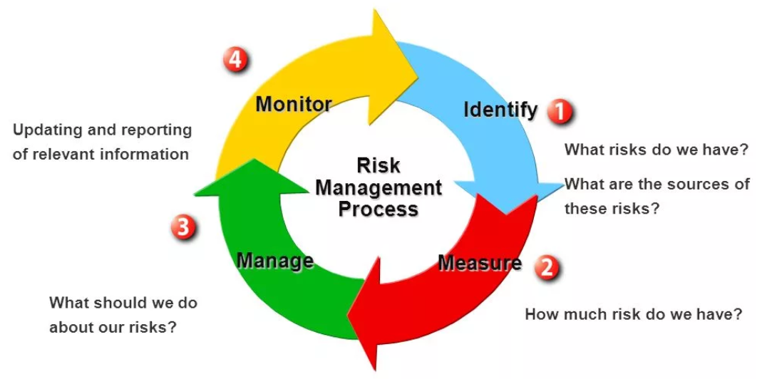
Let’s walk through each step of managing operational risk using the example of a bank robbery.

Slide 4
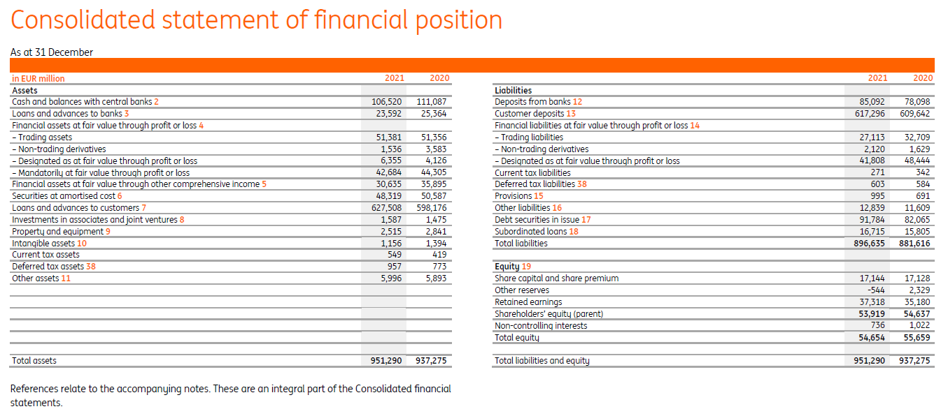
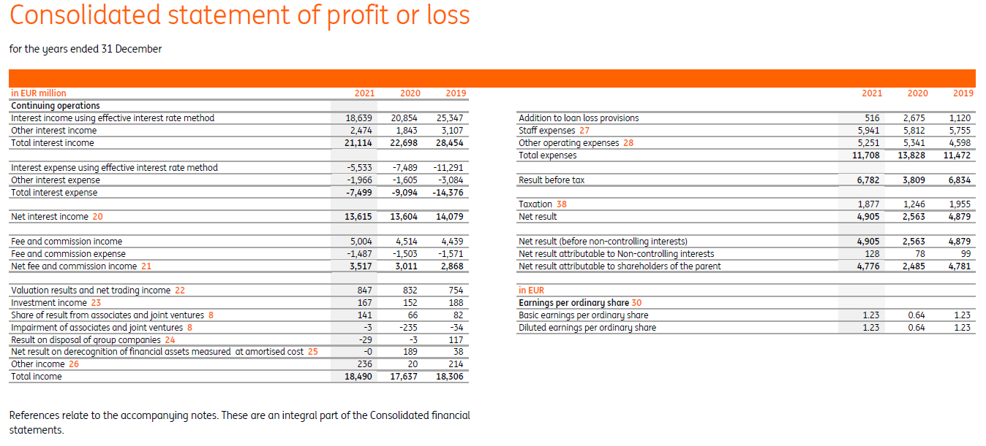
1. Identify: scope (1/2)
Step 1:
The Basel II categorizes
operational risk into eight business lines (BL):
Retail banking
Corporate banking
Trading and sales
Payment and settlement
Agency services
Asset management
Retail brokerage
Investment banking and advisory services.
Step 2:
For each BL should be established a list of Business processes (BP) => products that are provided by BL, for instance:
I. Retail banking: Retail loans: mortgage, cards, other retail;
II. Corporate banking: Loans to LE: Large, Medium, Small-micro;
III. Trading and sales: Operations by desks
Step 3:
For each BP should be explicitly defined responsible person/department. Such a person/department is called Risk Owner (RO)

Slide 5
1. Identify: self-assessment (2/2)
Each Risk owner in cooperation with the Risk management department performs a self-assessment:
Step 1: Review and evaluate the existing processes, systems, and controls in place to identify areas where operational risks may arise.
Step 2: Assess the probability and severity of each identified risk in the organization and prioritize risks based on their severity.
Step 3: Develop strategies to mitigate or reduce the impact of the identified risks, such as implementing new controls, enhancing existing processes, or improving technology systems.

Slide 6
2. Measure: operational risk loss database (1/3)
GPT ©
The main data source for operational risk management is the operational risk loss database. It is a collection of information about operational losses that have occurred within an organization.
The operational risk loss database should contain:
General Loss Event Information: date, time, location, and business unit involved
Risk type: fraud, IT failure, human error, compliance breach, etc (slide 4)
Root cause: a lack of controls, poor training, systems failure, etc
Loss Amount: financial impact of the loss event
Business Impact: impact of the event on the business, such as reputation damage, reporting misstatement and etc
Mitigation Measures: measures taken to mitigate the impact of the loss event, such as implementing new controls, adjusting existing processes, improving IT systems and etc
Related Documents: any relevant documents, such as investigation reports, audit reports, or regulatory filings.
Operational risk loss database – is a special focus of regulatory oversight. If the regulator reveals severe deficiencies, it may end up with add-ons for the capital adequacy ratio.

Slide 7
2. Measure: regulatory perspective (2/3)
IE7.1
Metric I - RWA for operational risk. There are 3 calculation approaches:
1. Standardized approach based on net PL result of the bank: $OR RWA=\text{BI}\text{ (}\text{Business} \text{Indicator}\text{) }\text{component}\text{ ∗ 12,5 ∗ 15\%}$ (details in IE 7.1)
2. Revised Standardized approach¹. Basically the same as the standardized approach: $OR RWA=\text{BI} \text{component}\text{ ∗ 12,5 ∗ }\text{Regulatory} \text{constant}\text{ ∗ }\text{ILM}\text{ (}\text{internal} \text{loss} \text{multiplier}\text{)}$, but with a few extensions: :
Minor adjustments in BI component calculations
Regulatory constant = 15% differentiated on the scale of the bank: higher the revenue = > bigger the bank => higher the coefficient
ILM (internal loss multiplier) based on average losses from operational risk registered in the operational risk loss database (slide 6). It is ~100% but may be higher or lower. (In Europe always 100%)
3. Advanced model approach. Main idea - VAR on factual operational risk realization. It was widespread in Europe and prohibited in Russia. Now is actively being replaced by the Revised Standardized approach in Europe.
Metric II – ECAP (economic capital for ICAAP purposes) for operational risk. The main calculation techniques:
In Europe often calculated by advanced model approach
In Russia is often aligned with Standardized or Revised Standardized approach amended by some management adjustments
¹OPE10 - Definitions and application (bis.org)

Slide 8
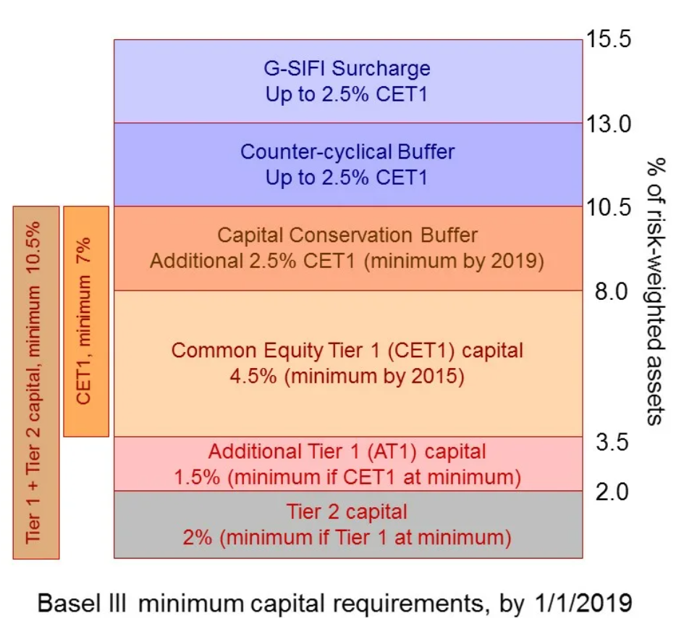
Capital adequacy ratio¹
IE2.2
Tier 1 (going concern) | Common Equity Tier 1 (CET1) | Sum of common shares (equivalent for non-joint stock companies* ) and stock surplus, retained earnings, other comprehensive income, qualifying minority interest and regulatory adjustments | (Н1.1) $\frac{CET 1}{RWA}$ > 4.5%
 | Additional Tier 1 (AT1) | Sum of capital instruments meeting the criteria for AT1 and related surplus, additional qualifying minority interest and regulatory adjustments | (Н1.2) $\frac{CET 1+AT1}{RWA}$ > 6%
Tier 2 (gone concern) |  | Sum of capital instruments meeting the criteria for Tier 2 and related surplus, additional qualifying minority interest, qualifying loan loss provisions and regulatory adjustments | (Н1.0) $\frac{CET 1+AT1+Tier 2}{RWA}$> 8%
Allowances used to regulate dividends:
Maintaining capital adequacy = 2.5%
Countercyclical buffer = 0%
Systematically important banks =1%
RWA = Credit risk + Market risk + Operational risk
¹https://www.bis.org/fsi/fsisummaries/defcap_b3.pdf
Criteria mentioned in the table above - https://www.bis.org/publ/bcbs189.pdf and 199-И for Russian specifics

Slide 9
2. Measure: added value perspective (not risk appetite) (3/3)
GPT ©
Metric III - limit on factual losses after realization of operational risk under Risk Appetite Framework
Metric IV – Key Risk Indicators (KRI) In addition based on the specific of the processes:
Internal Fraud. Quantity and severity of fraudulent activities by employees: theft, embezzlement, bribery, etc.
External Fraud. Quantity and severity of of fraudulent activities from external parties: customer fraud, cyber attacks, etc
Compliance Breaches. Quantity and severity of breaches of laws and regulations.
Customer Complaints. Quantity and severity of customer complaints.
Business Disruption. Duration and severity of operations disruptions or delays in customer service.
IT System Failures. Quantity and severity of IT system failures, including system downtime, data breaches, and other cyber incidents.

Slide 10
3. Manage: the control environment (1/3)
I. What are controls literally?:
Policies and procedures: Establishing policies and procedures that clearly define the desired behavior and expected outcomes can help to ensure that business processes are carried out consistently and effectively. The important part here are:
Separation of duties: Separating duties among different individuals or departments can help to prevent fraud or errors by ensuring that no one person has complete control over a process.
Authorization and approval: Authorization and approval processes can be used to ensure that only authorized individuals or entities are able to initiate or approve certain transactions or activities.
Physical controls: Physical controls, such as locks, access controls, and security cameras, can help to prevent unauthorized access to physical assets or sensitive information.
Automated controls: Automated controls, such as software programs or electronic checks, can help to ensure that processes are carried out consistently and accurately. For example, validate data entry or flag exceptions for further review.
Monitoring and reporting: Monitoring and reporting can help to identify problems or errors in a timely manner, allowing for corrective action to be taken before they become more serious.
II. Implementation of controls costs money. Bank need to find the trade-off between quality and the cost. For this purpose the following matrix based on operational risk probability and severity can be used:
The exception from this matrix - regulatory obliged controls. For instance AML/CFT – Anti-money laundering and combating the financing of terrorism. Bank obliged to have decent controls in place even if it brings ~0 added value for the business.
 | Low severity | Medium severity | High severity
Low probability | No controls | Low control quality | Medium control quality
Medium probability | Low control quality | Medium control quality | High control quality
High probability | Medium control quality | High control quality | Highest control quality

Slide 11
3. Manage: control types (2/3)
Type of control | Description | Minimize probability of realization | Minimize severity of realization
Preventative | These controls are designed to prevent operational risks from occurring. Examples include procedures for segregating duties, background checks for employees, and cybersecurity measures | X
Detective | These controls are designed to detect operational risks that have already occurred. Examples include internal audits, management reviews, and employee training programs. |  | X
Corrective | These controls are designed to correct operational risks that have already occurred. Examples include system repairs, process improvements, and employee disciplinary actions |  | X
Directive | These controls are designed to provide direction to employees on how to perform their tasks. Examples include policies, procedures, and guidelines. | X | X
Deterrent | These controls are designed to deter employees from engaging in risky behavior. Examples include sanctions, consequences for violating policies, and internal investigations. | X | X
Compensatory | These controls are designed to compensate for the absence of other controls. Examples include backup systems, redundant processes, and contingency plans. | X | X

Slide 12
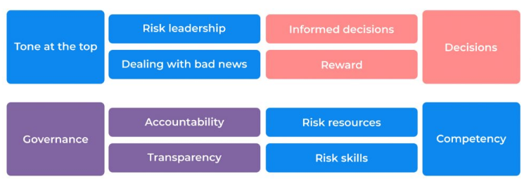
3. Manage: Risk culture (3/3)
Risk Culture is an essential component that enforces the efficiency of the control environment of all Business lines and Business processes

Slide 13
4. Monitor
Step 1. Metrics I - IV should be settled on an annual basis. Depends on the significance of the product metrics need to be decomposed on the level of:
Business line (BL)
Business process (BP)
Risk Owner (RO)
Step 2. Organize reporting to all relevant stakeholders:
Regulator:
Top management:
responsible for business lines performance
management board
Internal and external auditor
Step 3. Monitor the metrics and if any outliers occur:
Urgent management response
Refinement of limits

Slide 14
Operational risk – Cases
JPMorgan Chase: In 2012, the bank suffered a multi-billion dollar trading loss due to poor risk management and oversight. The incident was attributed to the actions of a single trader, known as the "London Whale.“
Wells Fargo: In 2016, the bank was fined $185 million for opening millions of unauthorized accounts on behalf of customers without their knowledge or consent. The scandal was attributed to aggressive sales practices and weak internal controls.
Equifax: In 2017, the credit reporting agency experienced a massive data breach that compromised the personal information of over 140 million consumers. The breach was attributed to a failure to patch a known vulnerability in a web application, as well as weak cybersecurity practices.
Societe Generale: In 2008, the bank suffered a multi-billion dollar trading loss due to unauthorized trades made by a single trader “he had taken massive fraudulent directional positions in 2007 and 2008 far beyond his limited authority". The incident was attributed to a lack of oversight and control mechanisms, as well as the trader's ability to bypass existing checks and balances.

Slide 15
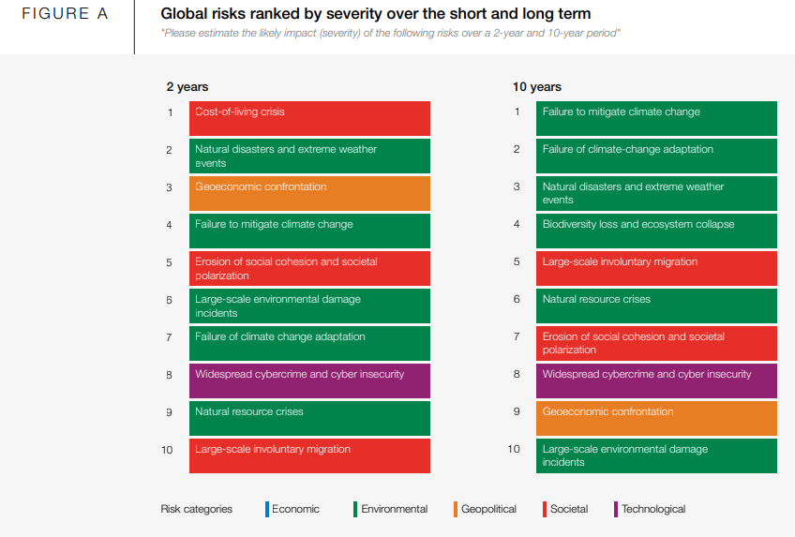
Operational risk – 2023 Risk report overview

